Slide 1


Slide 2
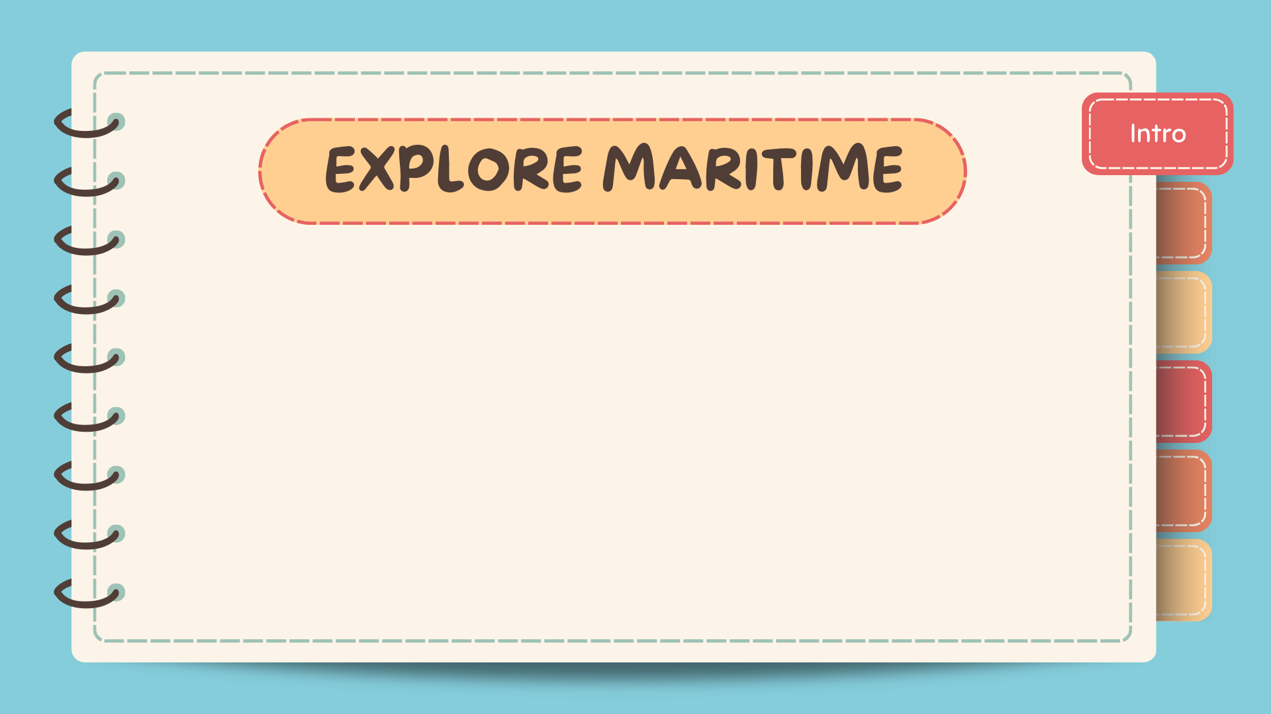
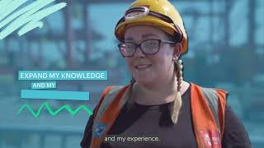

Slide 3
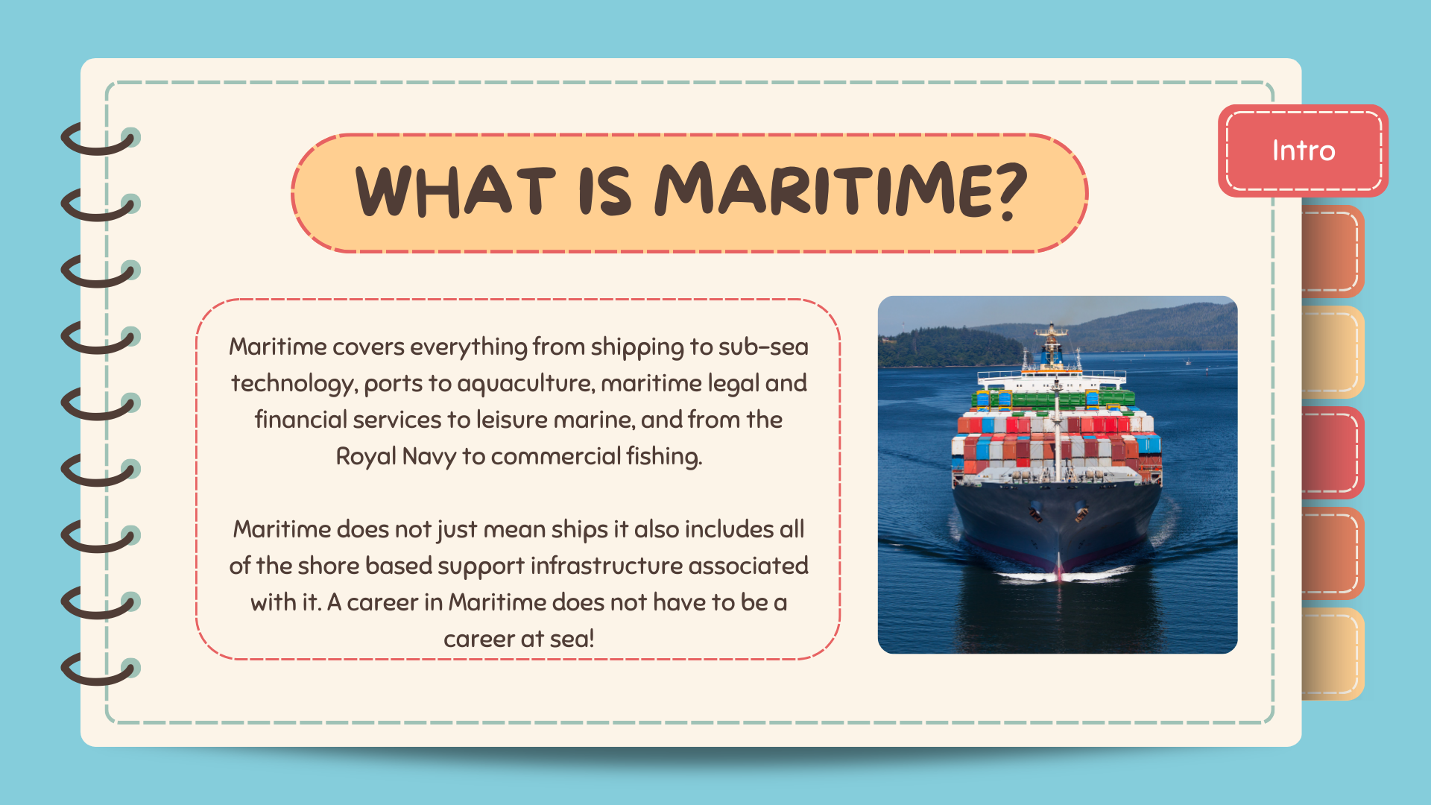

Slide 4
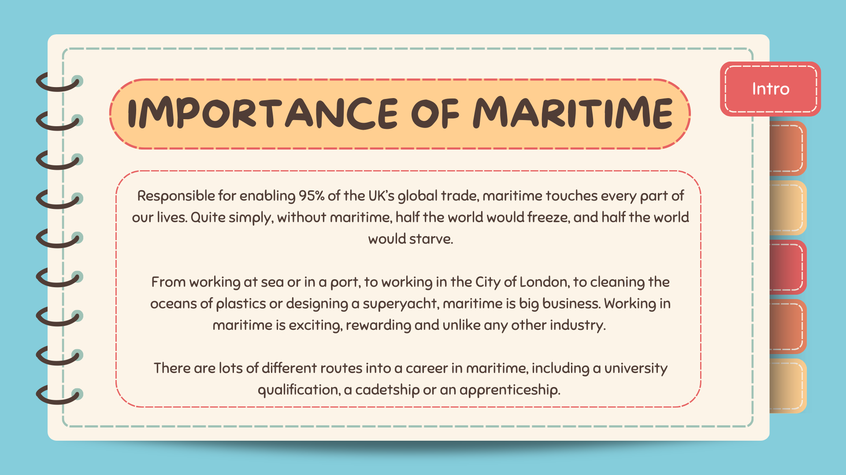

Slide 5
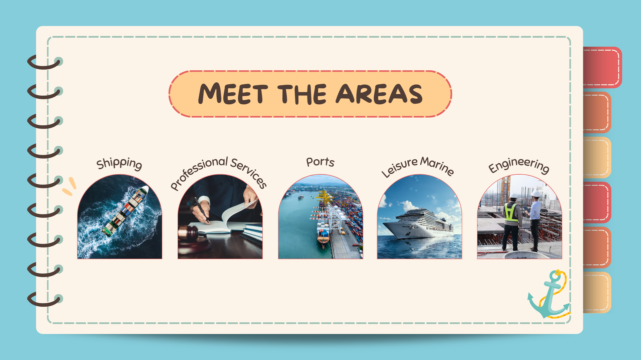
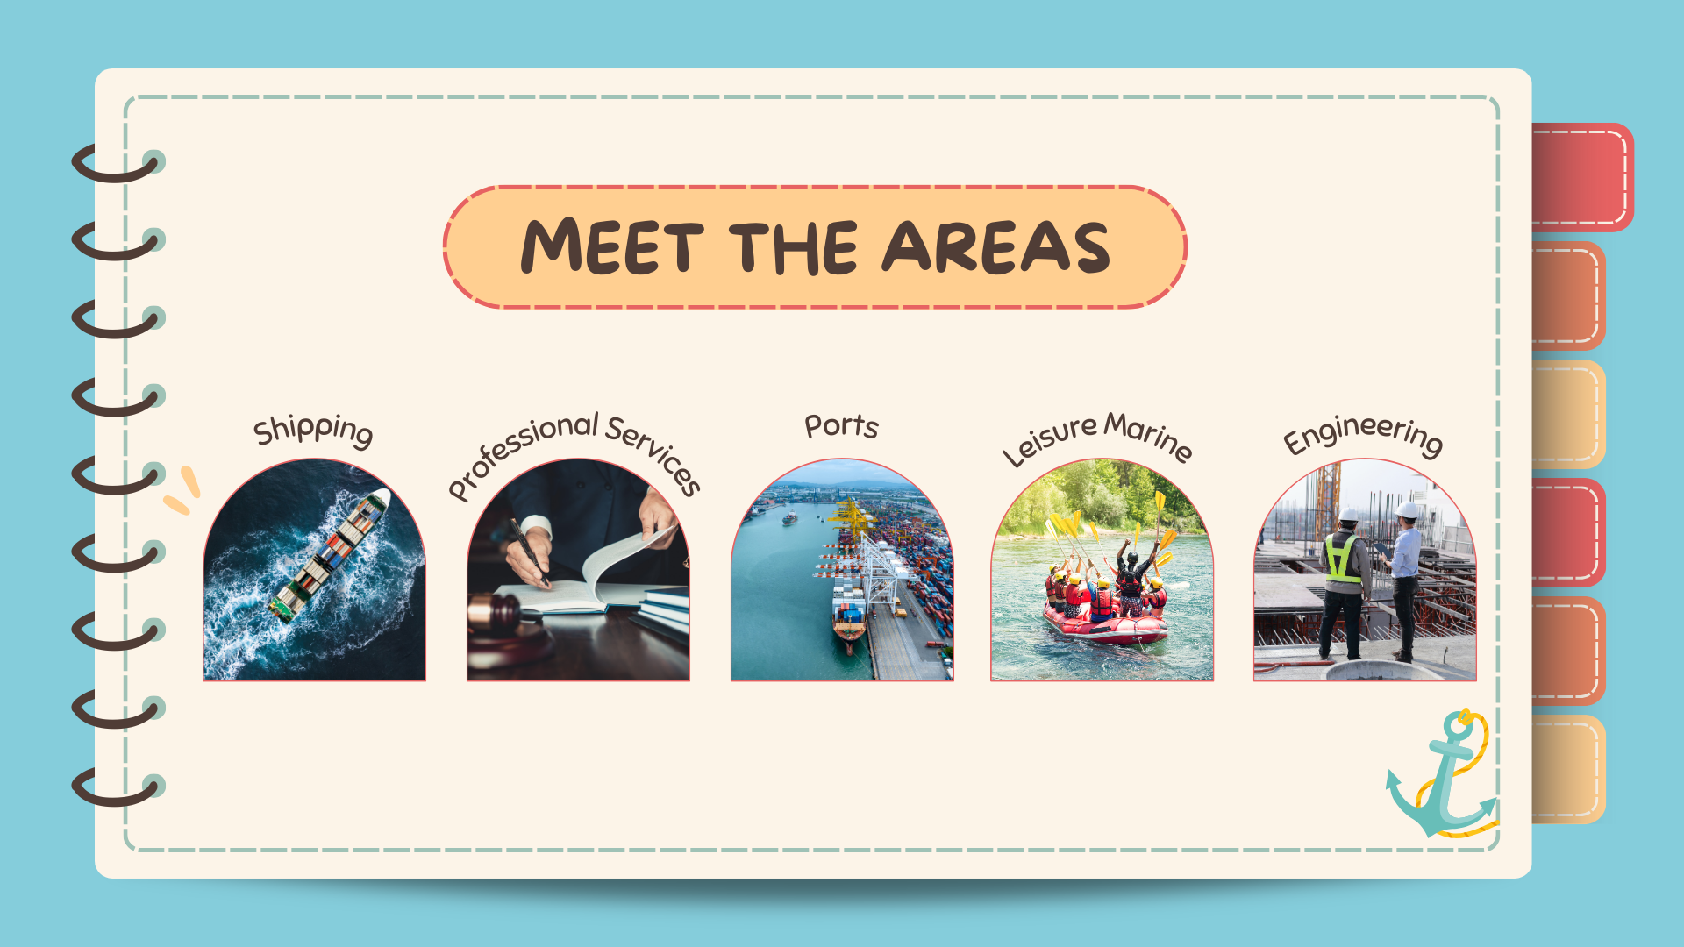
Notes:
SHIPPING
95% of all imports and exports are moved by sea. Manufacturers rely on shipping to import their raw materials, and to export their finished goods.
The majority of UK shipping can be grouped under one of 3 categories
Royal Navy
Merchant Navy
Fishing
PORTS AND HARBOURS
We are an island nation, so almost everything you use, eat or wear will have come through a UK port. Every year, more than 20 million passengers and 500 million tonnes of cargo move through UK ports – 95% of our international trade.
Ports and harbours employ a wide range of people to ensure the smooth and effective movement of goods between ship and shore.
PROFESSIONAL SERVICES
Maritime requires a large support network to ensure its success, safety and smooth operation. Professional service roles are usually shore based and can often be done remotely. Professional services include:
Maritime Lawyers
Maritime Insurance specialists
Ship Brokers
Ship’s Agents
LEISURE MARINE
Diverse career opportunities are available in the leisure, small commercial and superyacht industry. Over 4600 companies with a combined worth of over £3 billion have a variety of career opportunities. The industry is also at the forefront of innovation, pioneering new technology, world-renowned craftsmanship and a world leader in design.
ENGINEERING
Engineering is all about solving problems using specialist technical and practical skills. It’s all about maths, science, research, prototypes, design, maintenance and production.
Every industry and every area of society depend on the precise and efficient work of engineers. Engineers provide technological solutions to the problems, issues and ideas that affect every area of our lives.
There are roles for engineers in the maritime sector on shore and at sea.

Slide 6
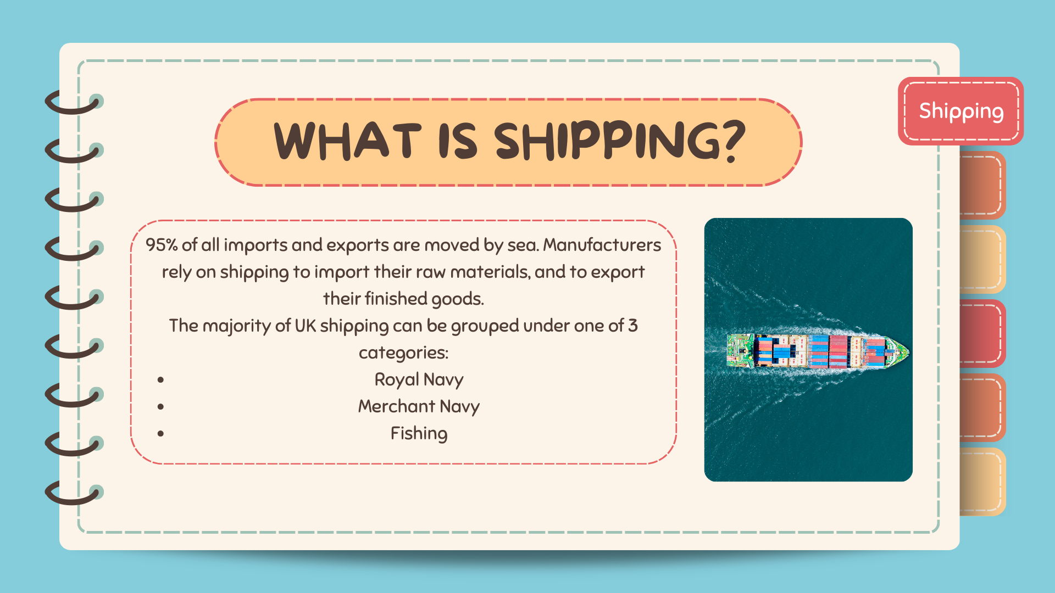
Notes:
The Merchant Navy is the collective term for commercial shipping, which is different to the Royal Navy or personal leisure craft users, and includes cargo ships, tankers, ferries and cruise ships. Jobs are varied and include Deck, Catering, Hospitality, Communications, Engineering and Electro-Technical officers and crew.
The Royal Navy (RN) is the United Kingdom's naval warfare force, responsible for defending the UK at sea, protecting shipping and fulfilling international military agreements.
Part of the Royal Navy, the Royal Fleet Auxiliary (RFA) is a civilian maritime force that supports the Royal Navy and Royal Marines with logistics and operations.
The Royal Navy employs over 30,000 personnel as well as more than 3,000 reserve personnel and offer a wide range of career opportunities.
Sea Fishing and aquaculture is a multi-billion pound industry in the UK. There are a wide range of jobs on offer, depending on the size of the vessel, the type of catch and the area of operation.
Sea fishing is a uniquely challenging and often very satisfying career. Frequently described as the “last of the hunters”, the men and women who crew and operate the fishing boats that harvest the rich ocean resources in our waters are dedicated, highly skilled and well rewarded.
Commercial fishing is no longer a male only career as more and more women enter the industry and progress to the ultimate goal of being skipper of their own fishing vessel.
Whether it’s operating a small day boat or a multi-million pound deep sea trawler there’s always a new challenge every trip. There are opportunities not just for work but for adventure in every part of the industry.

Slide 7
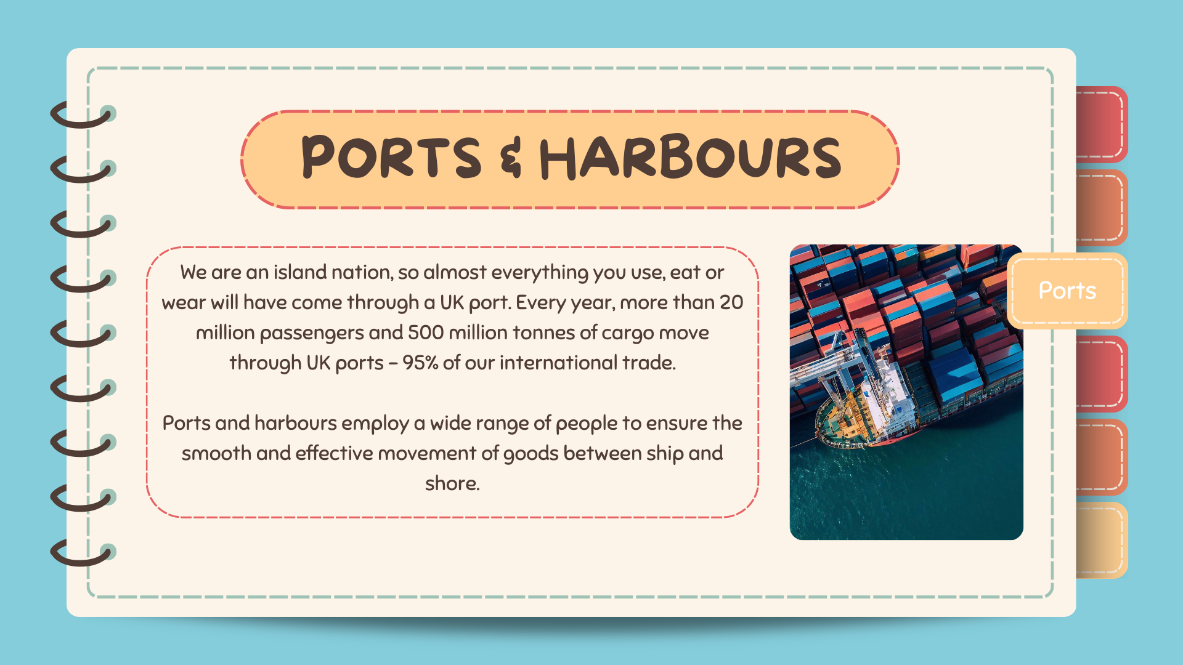
Notes:
There are ports, harbours and marinas all the way round our coast supporting a wide range of uses like:
the import of oil and gas, and support for our fast-growing offshore wind industry
container ships
lots of other freight traffic like cars, chemicals, paper and steel
ferries and cruise ships
Royal Navy
leisure
That variety means that ports and harbours offer a wide range of type of career:
Operations – port operations and plant, with increasing use of the latest technology to move goods efficiently and in the most environmentally-friendly way
Engineering – mechanical, electrical, civil, design, fabrication and welding
IT, data and technology
Marine – hydrography, pilotage, harbour master, vessel traffic services (the marine equivalent of air traffic control)
Logistics – warehousing and transport
Health and safety
Marketing and communications
Finance and accounting
Legal
Administration and security
Planning and licensing
Environmental
Property

Slide 8
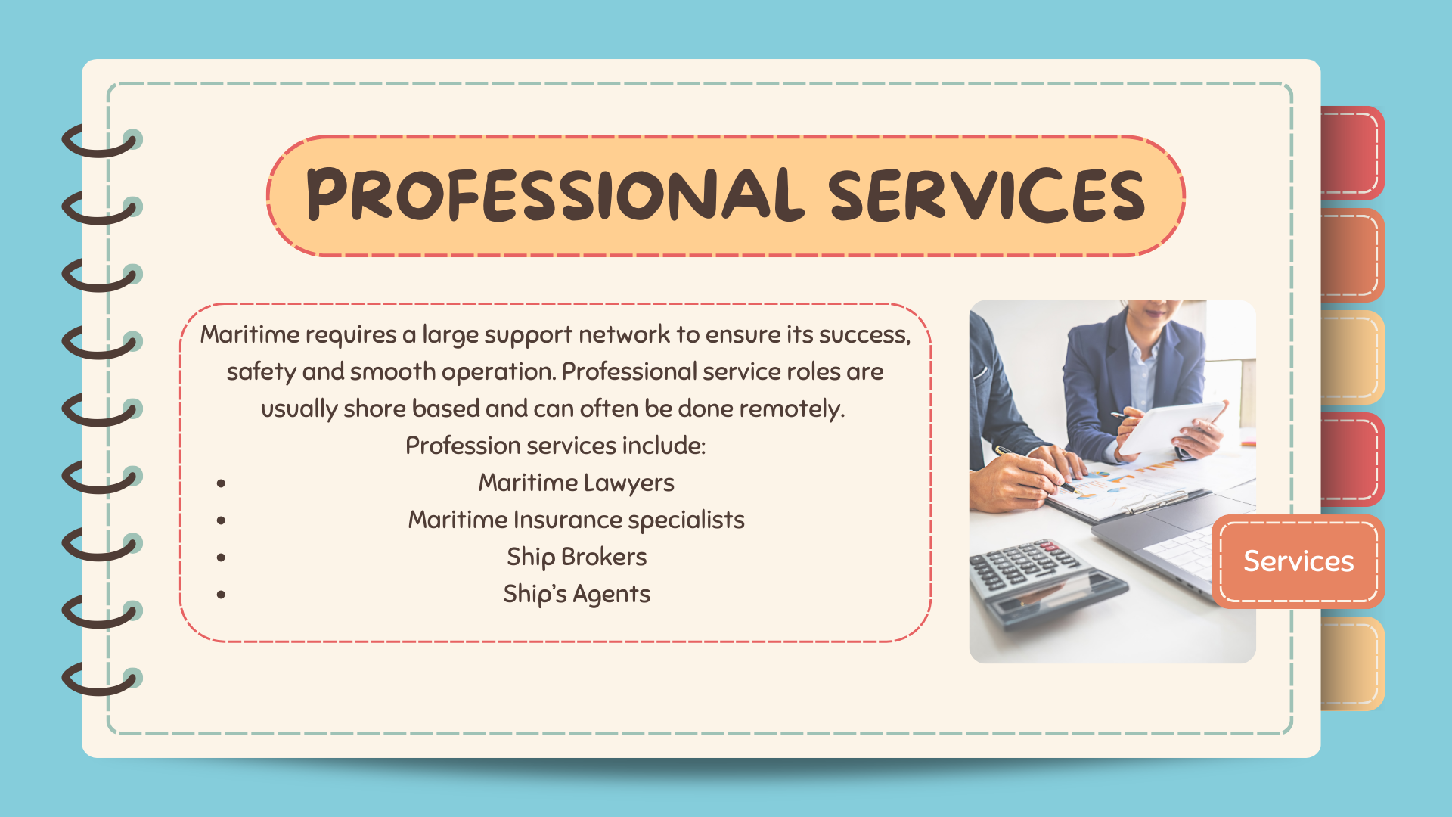

Notes:
Maritime law, also known as admiralty law, is a set of laws and regulations that govern activities in navigable waters which covers a wide range of issues, including shipping, navigation, marine pollution, fishing, and piracy. It also defines the rights and responsibilities of people involved in maritime activities, such as passengers, crew, and shipowners.
Maritime insurance, also known as marine insurance, protects against the loss or damage of goods, ships, terminals, and other transport vessels during the transportation of goods by land or sea. It can cover the entire journey, including land and sea.
A ship broker is someone who facilitates the buying, selling, and chartering of ships, and negotiates deals between the parties involved
A ship's agent, also known as a port agent or maritime agent, is a person or company that acts as an intermediary between a ship and the port authorities, local service providers, and the ship's captain. They are responsible for the ship's administrative and logistical needs, and ensure that the ship runs smoothly while docked.

Slide 9
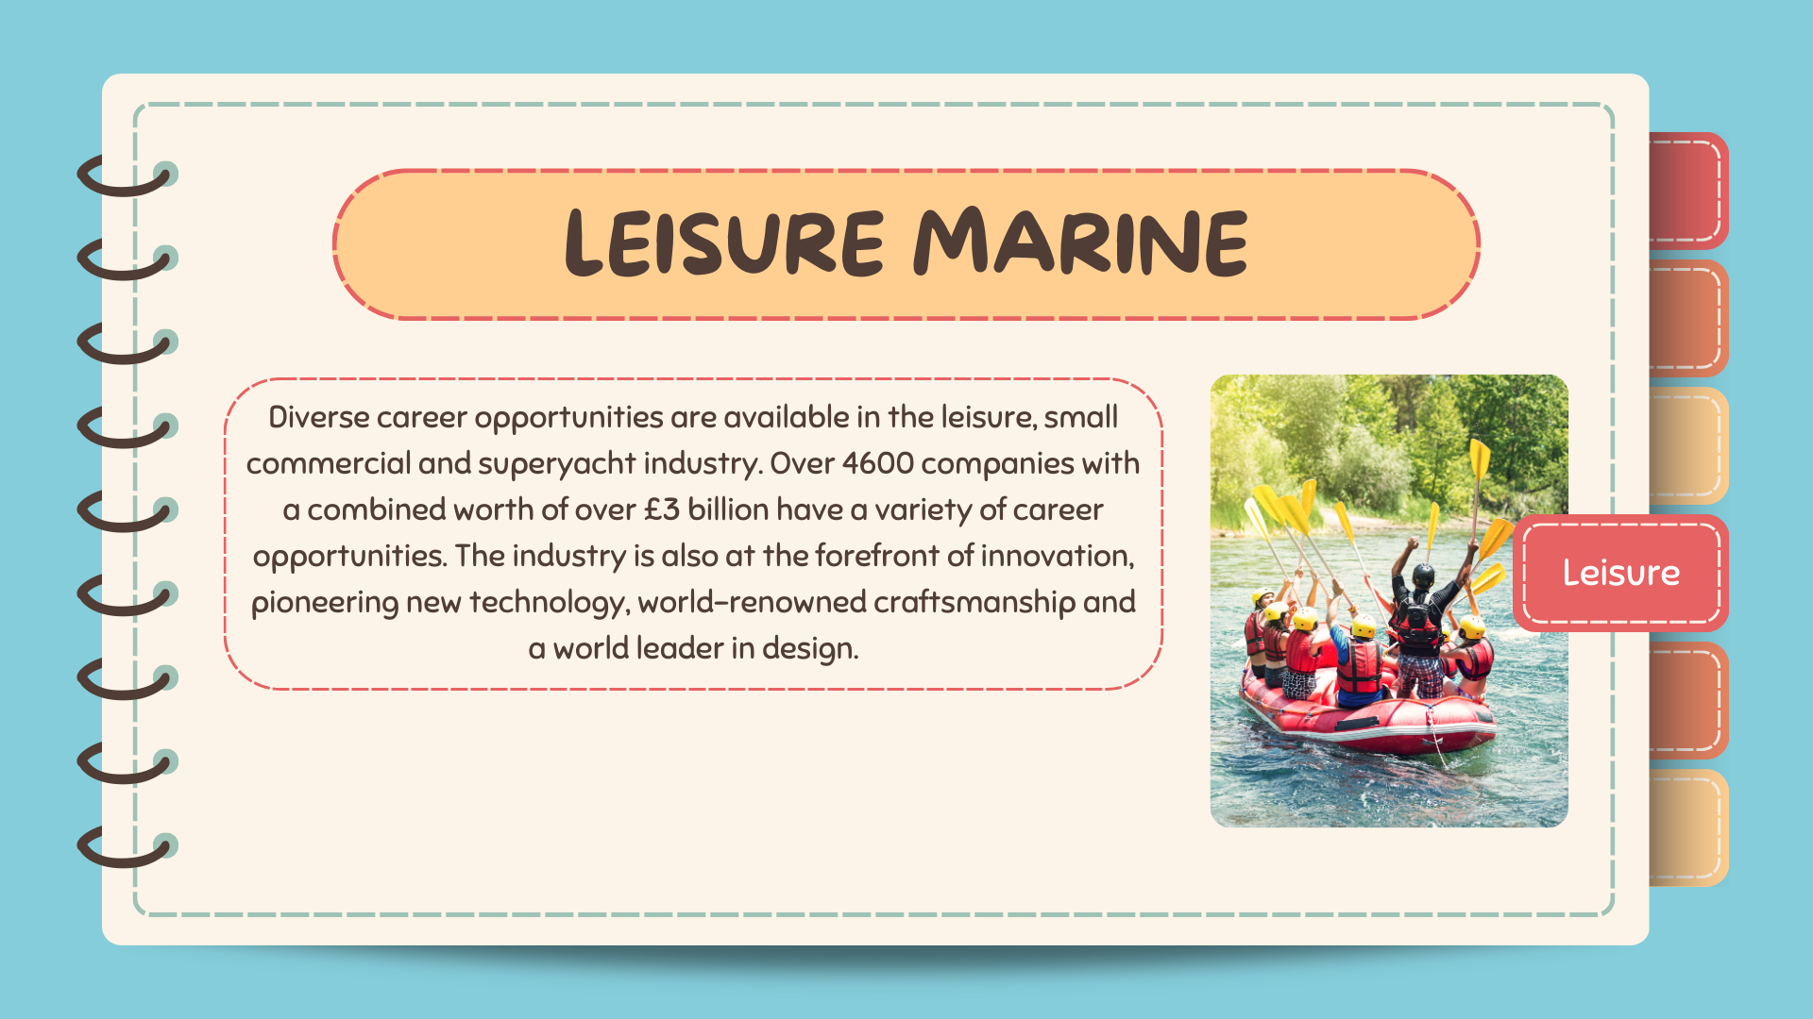
Notes:
Superyachts are large and luxurious, owned or chartered by the rich and famous, usually in sunny places, and operated by a professional crew who are working to ensure that the guests on board have a great time. The number of superyachts being built around the world is increasing every year and there is now a shortage of skilled workers to crew them.
Behind the glamour every superyacht needs professional crew:
a Captain, who is in overall charge
navigational officers who get the yacht safely to where it’s going
engineers who keep the engine and other equipment running smoothly
deckhands, with many roles including keeping the yacht looking magnificent
catering and hospitality crew who look after the guests, working to make sure they have a memorable trip.
The smallest superyachts are the length of a tennis court and have maybe four crew. The very largest are bigger than a destroyer and have a crew of 70 or more.
In the wider superyacht industry there are also many opportunities ashore in design and building both sail and motor yachts, sales and marketing, operating marinas, and a range of other support roles.
Superyacht crew work hard but the rewards can be generous and it’s a great way to see the world in style.

Slide 10
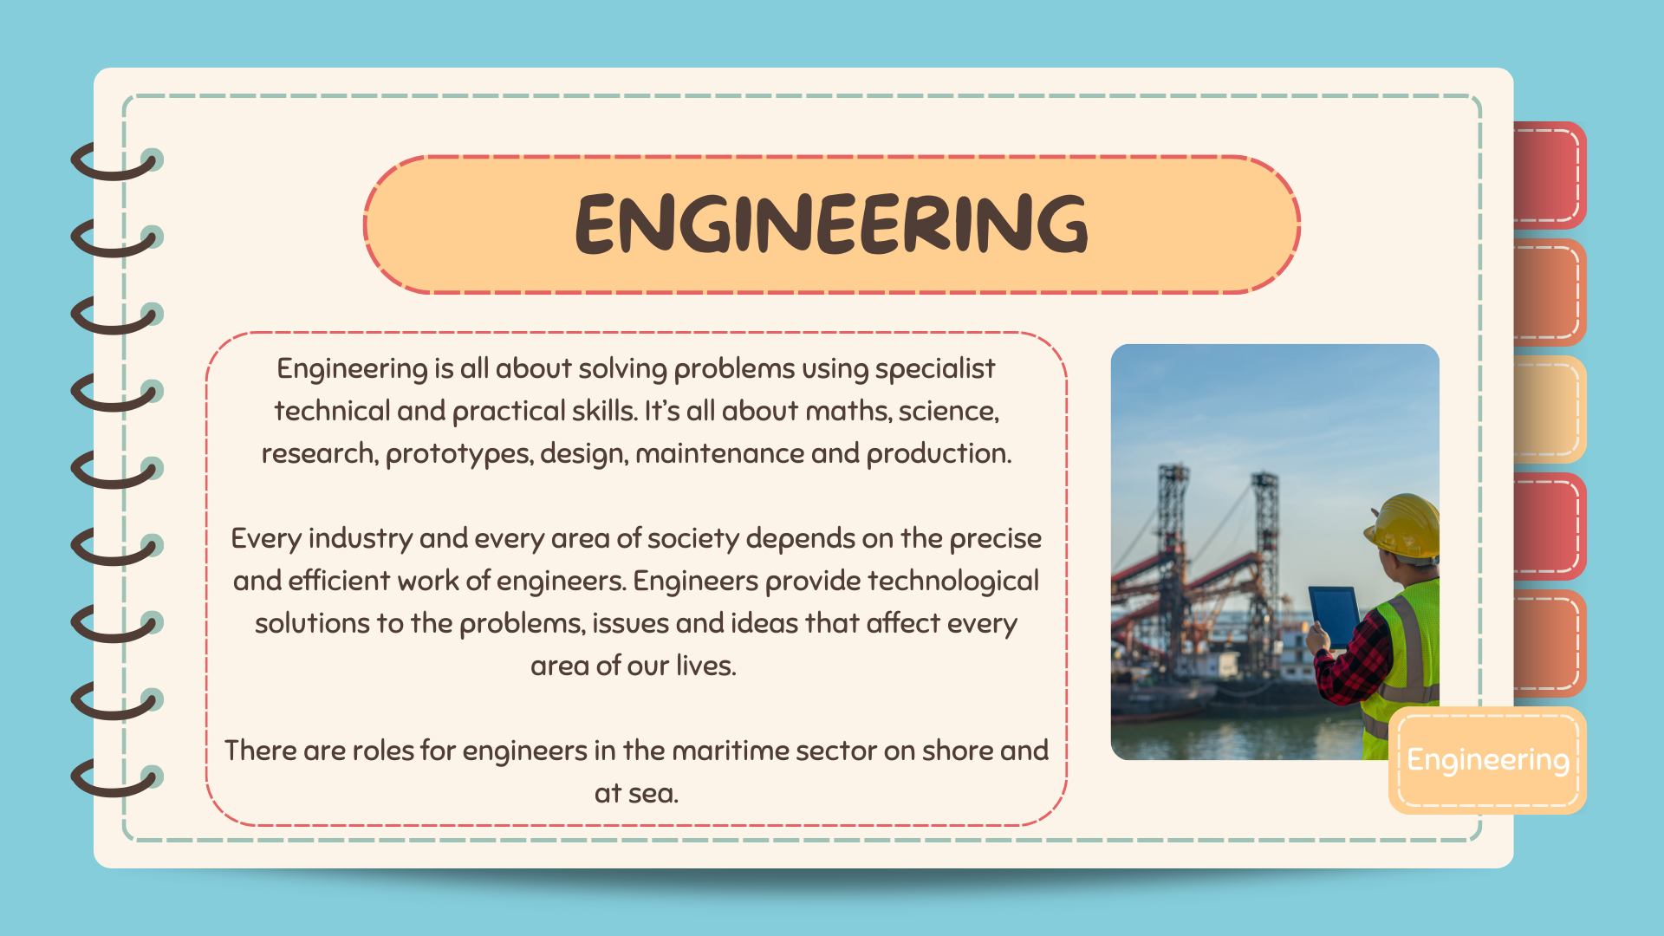
Notes:
Marine engineers are involved in the design, construction, installation, operation, maintenance and repair of the main propulsion engines and auxiliary machinery and systems found in all kinds of ships, boats and offshore installations.
Marine engineers work on engines and auxiliary equipment in the boatbuilding and shipbuilding industries and associated companies. A number of engineering disciplines – such as mechanical, electronic and structural – are involved. Marine engineers need to understand the effects of wind, waves and corrosion. Ships, boats, underwater structures, and the systems within them must be capable of operating in demanding conditions.
Marine engineers employed by merchant shipping companies work on different kinds of vessels, from cruise ships to tankers. They are responsible for the operation and maintenance of the engines, as well as the electrical and electronic equipment. Engineering ratings undertake routine maintenance and repair work in the engine room, check instrument readings and operate controls.

Slide 11
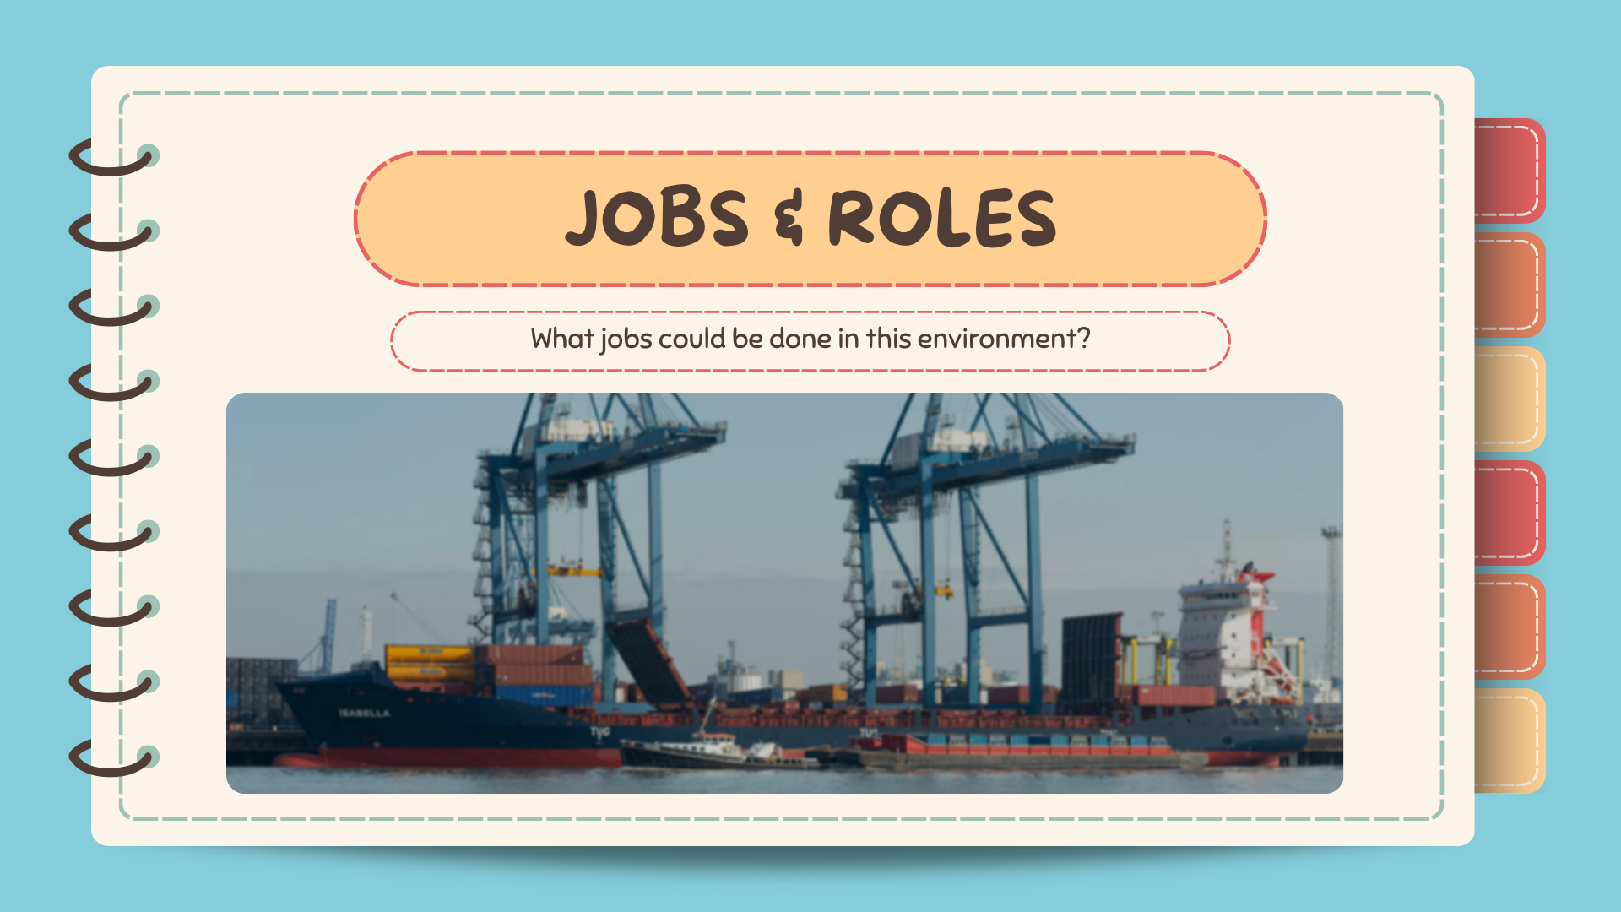
Notes:
The focus is on the range of jobs which could be done and to guide students towards the realisation that almost any job found outside maritime can be found in Maritime in addition to a range of specialised jobs and roles.
For example someone considering a career as a chef might consider that working for a cruise line or other shipping company would give them the same, skills, training and career opportunities as a chef in a land based restaurant while allowing them to travel and earn higher wages at the same time.
Or someone considering a career as a mechanic might consider a career in mechanical engineering, instead of working on car engines they could be working on engines the size of a bus.

Slide 12
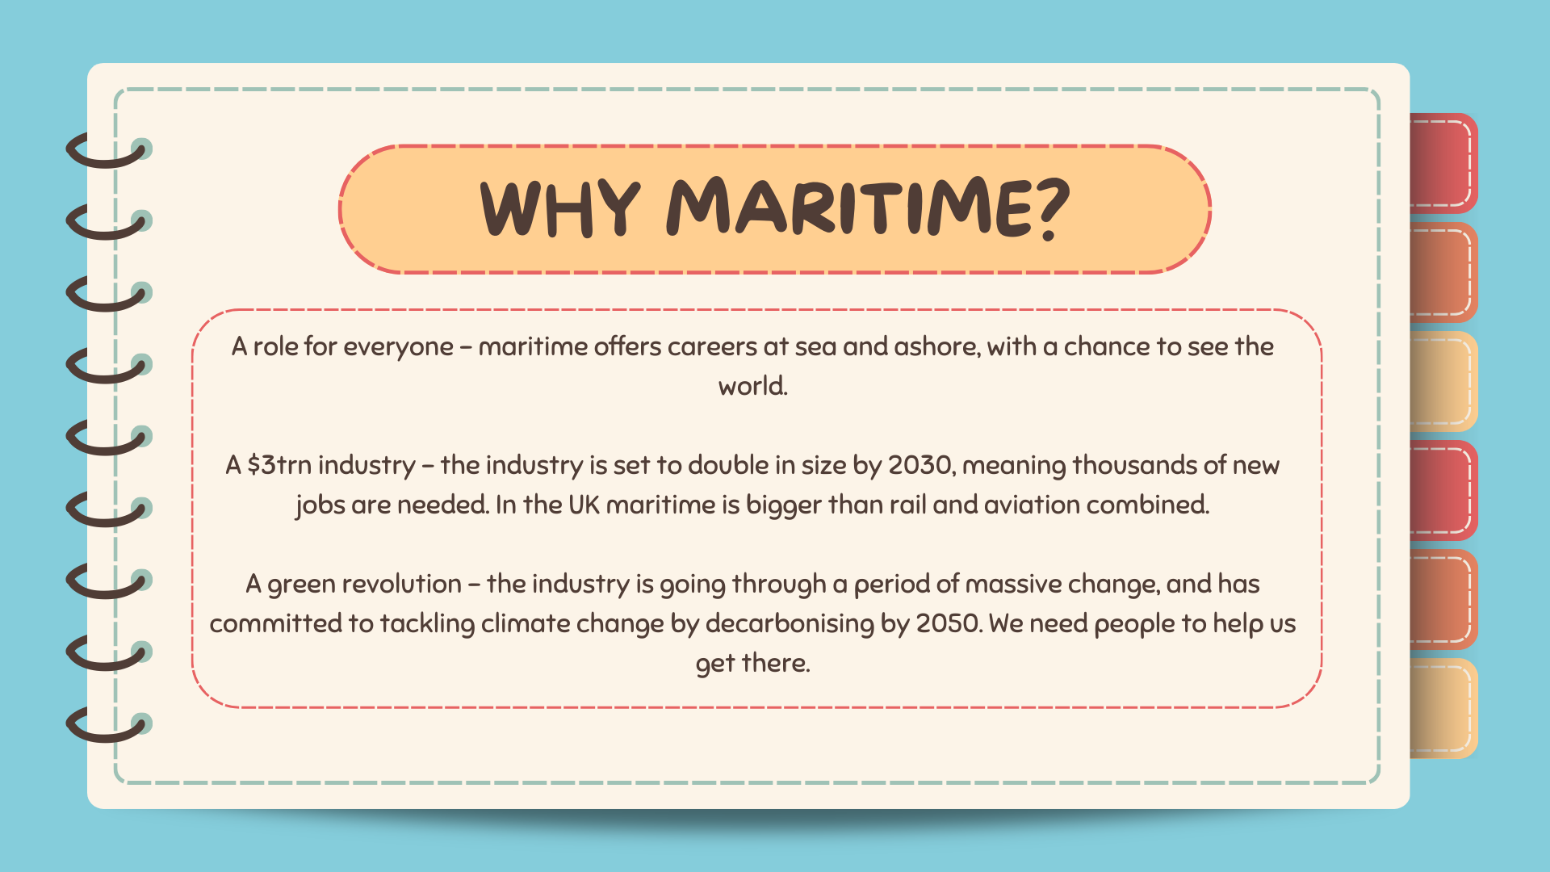

Slide 13
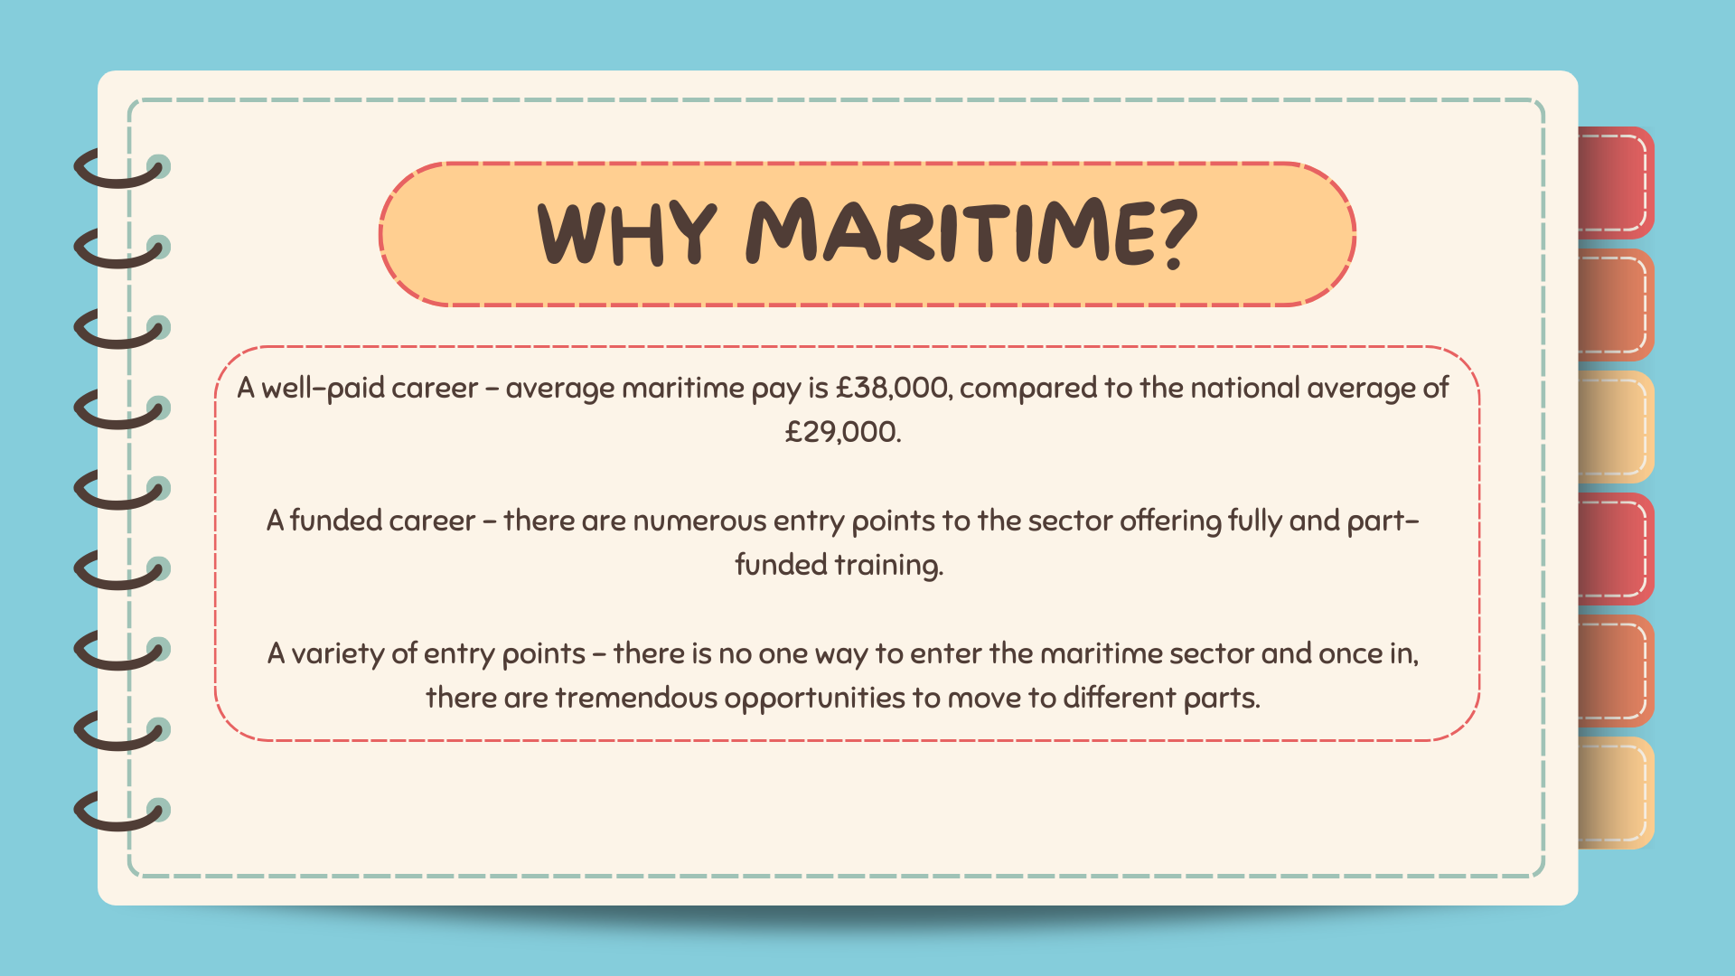

Slide 14
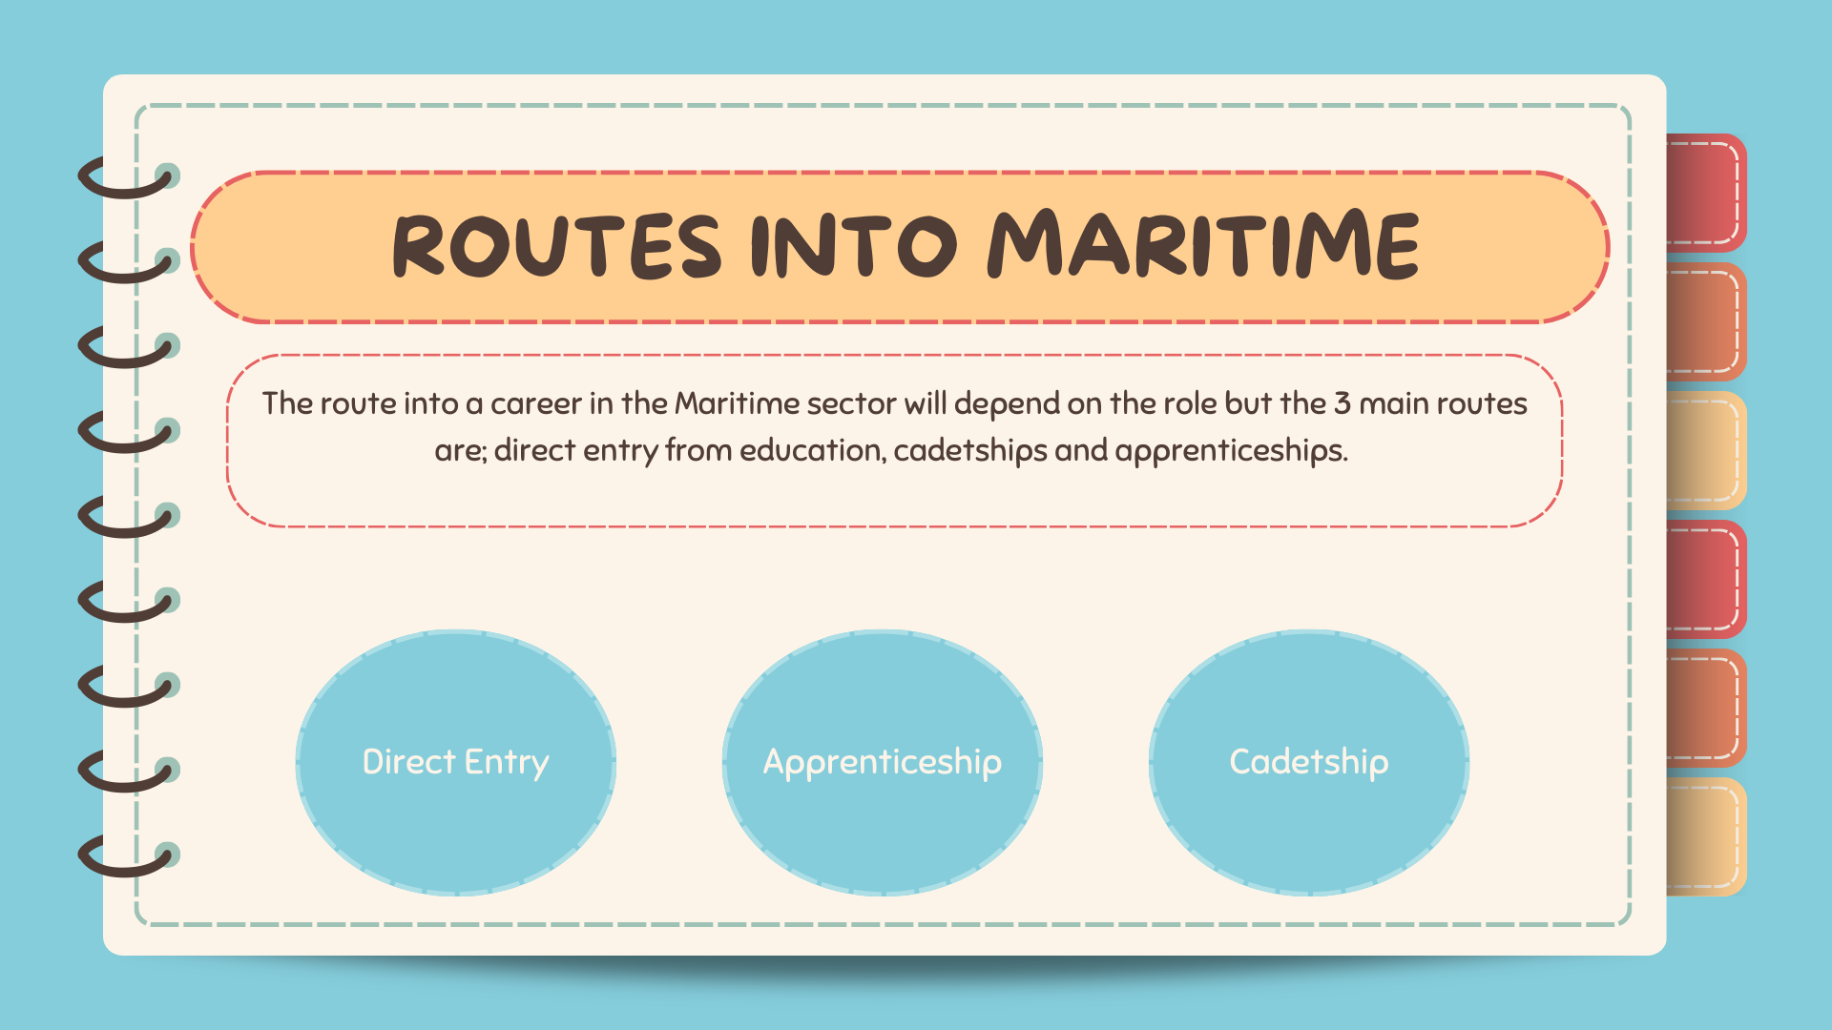

Slide 15
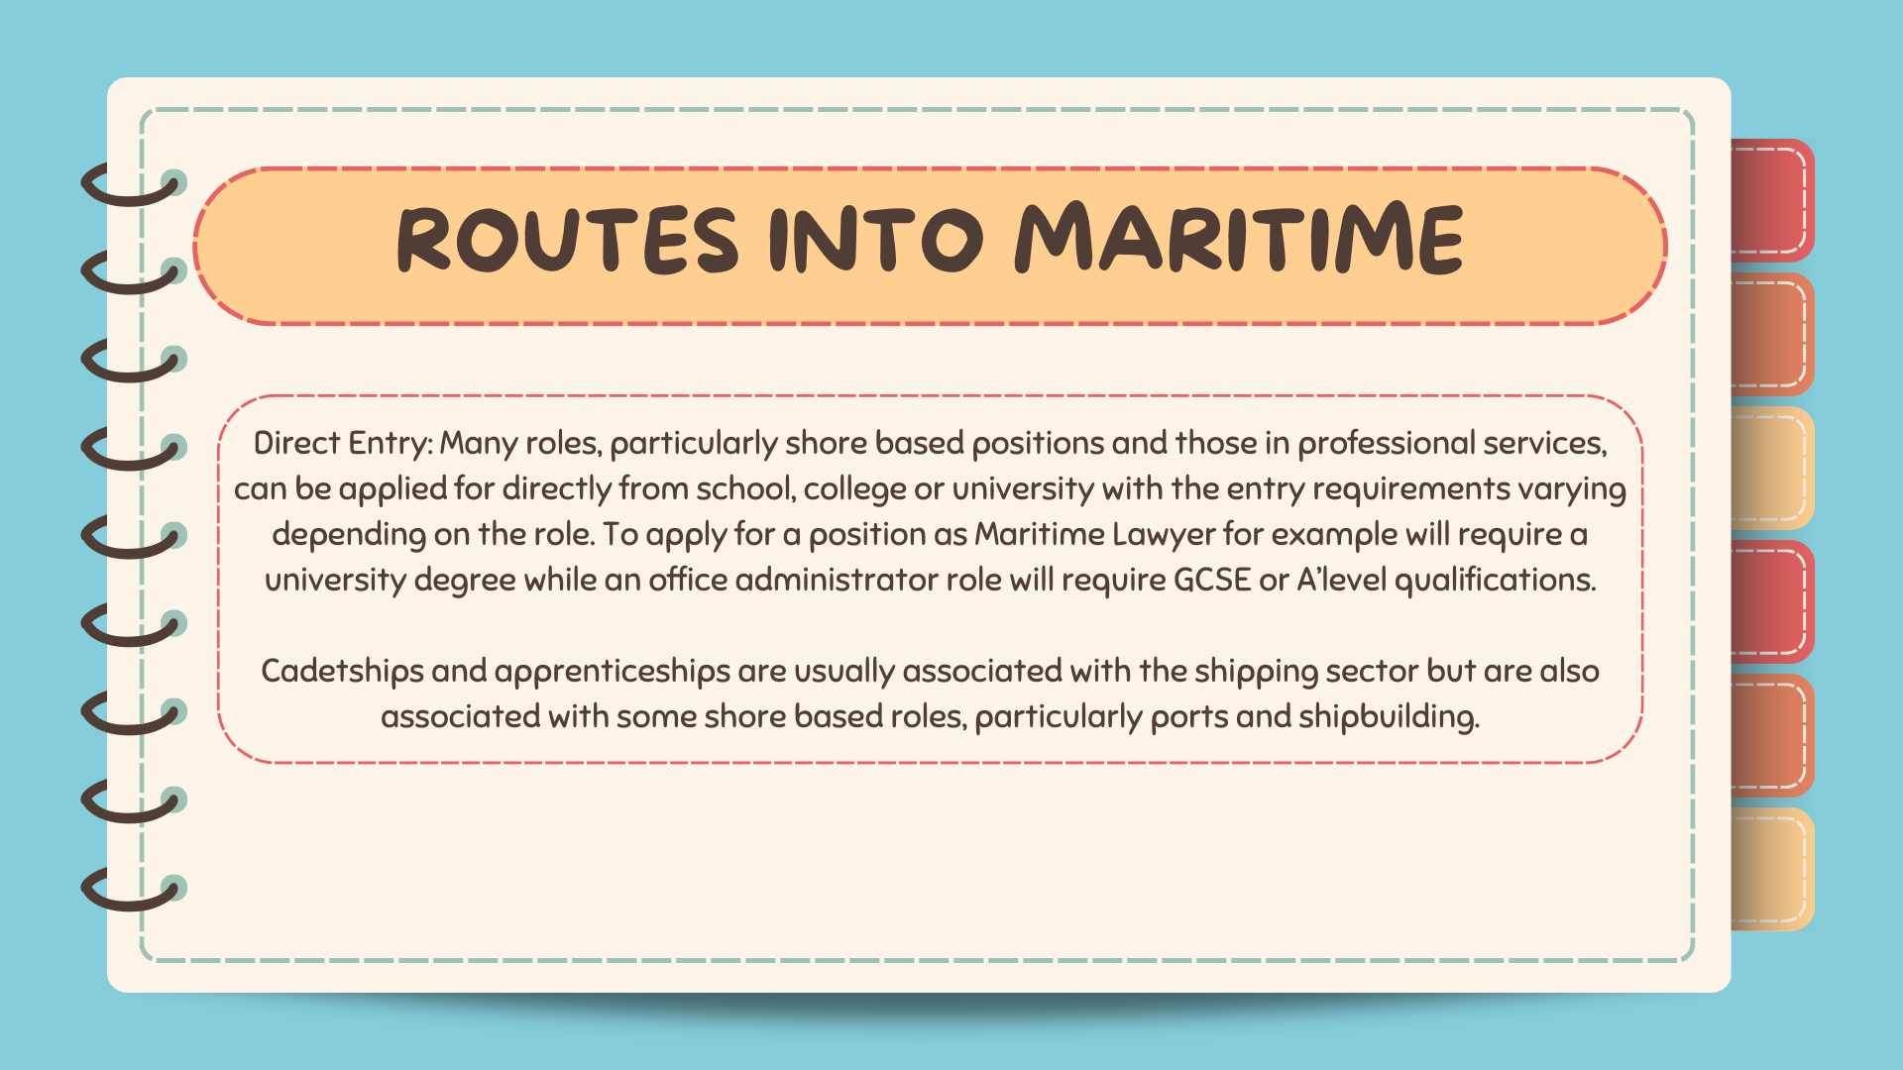

Slide 16
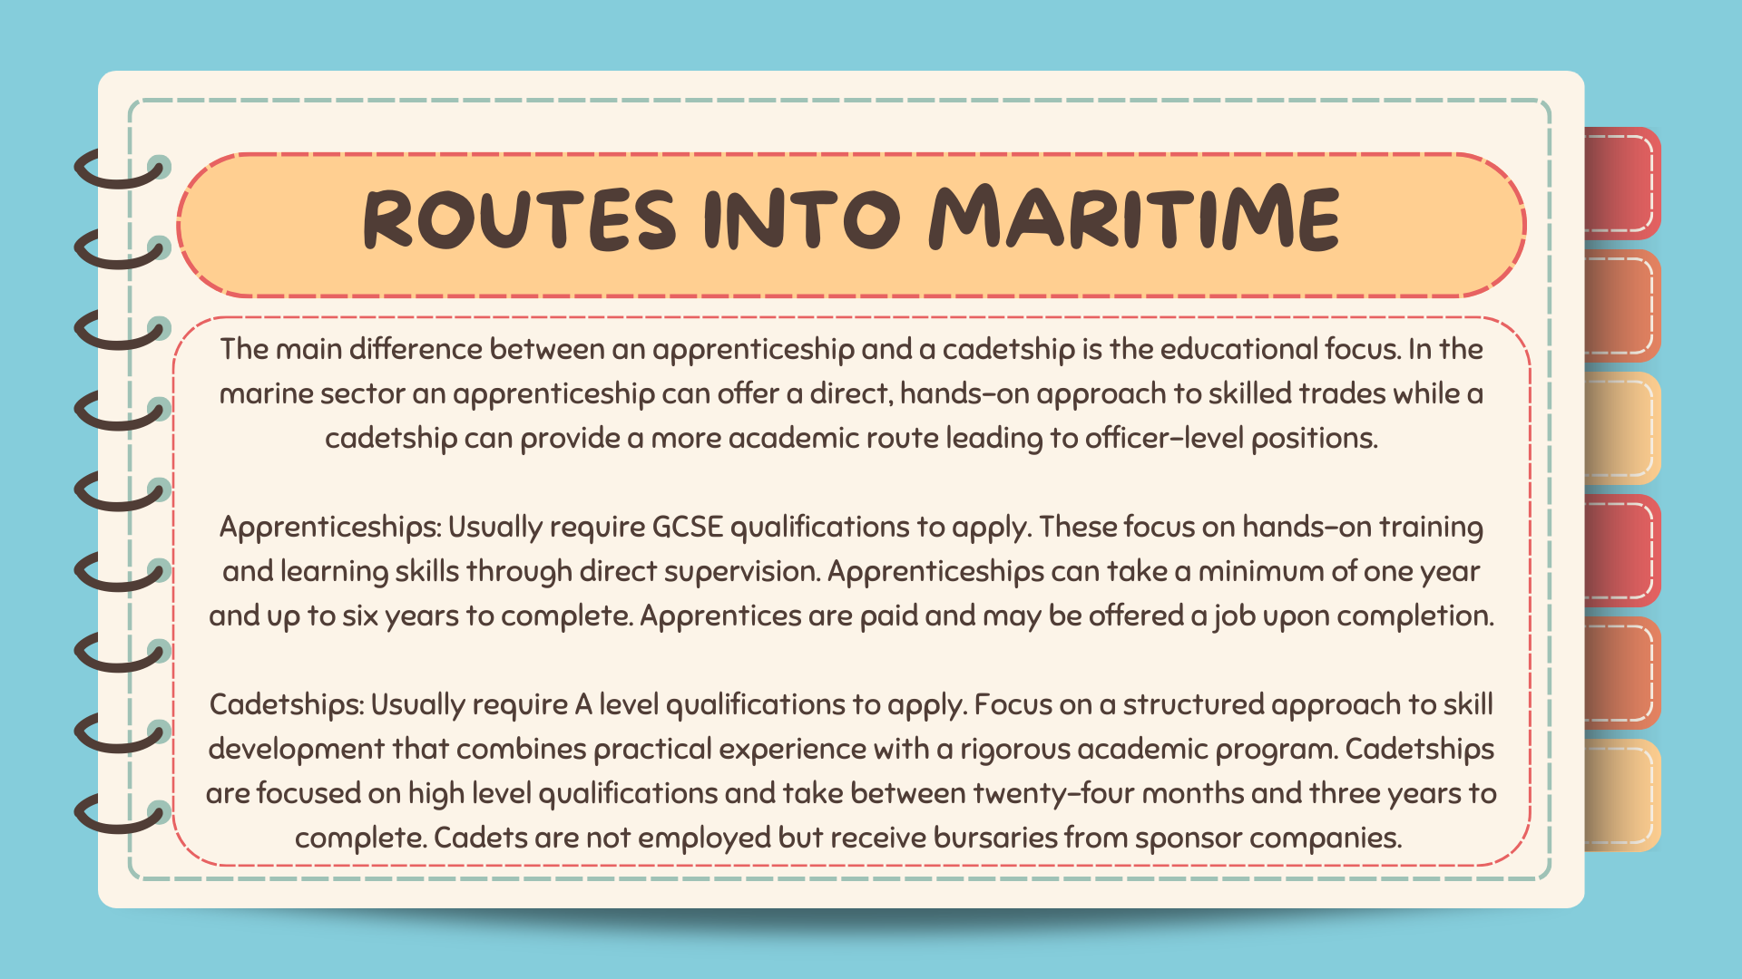

Slide 17


Notes:
The apprentices in this video are from Associated British Ports but apprenticeships are available for all aspects of maritime from building ships to sailing on them, everything necessary to keep them at sea and everything necessary to keep good flowing to and from our ports. Apprenticeships usually only require GCSE level qualifications as an entry level.

Slide 18


Notes:
These videos are from Electro-Technical cadets who design, maintain and repair electrical systems but cadetships are available for a wide range of officer level positions such as deck officers who steer and navigate ships as well as overseeing all activity on deck, mechanical engineering officers who design, maintain and repair engines and mechanical machinery as well as naval architects who design and build ships. The Institute of Chartered Shipbrokers doesn’t offer cadetships but does offer educational support to people wishing to go into Maritime Support Services.

Slide 19
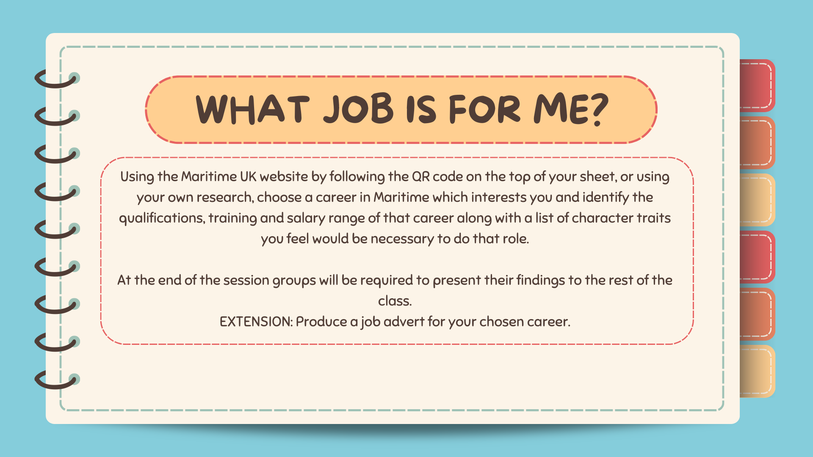

Slide 20
