Slide 1

Welcome to the world’s maritime centre
Name Name

Slide 2
The UK is a leading, outward-looking, global trading maritime nation.
We are the world’s maritime centre and are proud to offer a unique and complete package for maritime business.

Slide 3
Cutting-edge technology
High-quality design & manufacturing
Unparalleled expertise in services
Major investment opportunities
The UK is the natural home for your maritime business

Slide 4
Cutting-edge technology

Slide 5
UK ranked the UK as one of the most innovative countries in the world
World’s leader in ICT innovation
Culture of innovation is embedded within the UK’s maritime sector

Slide 6
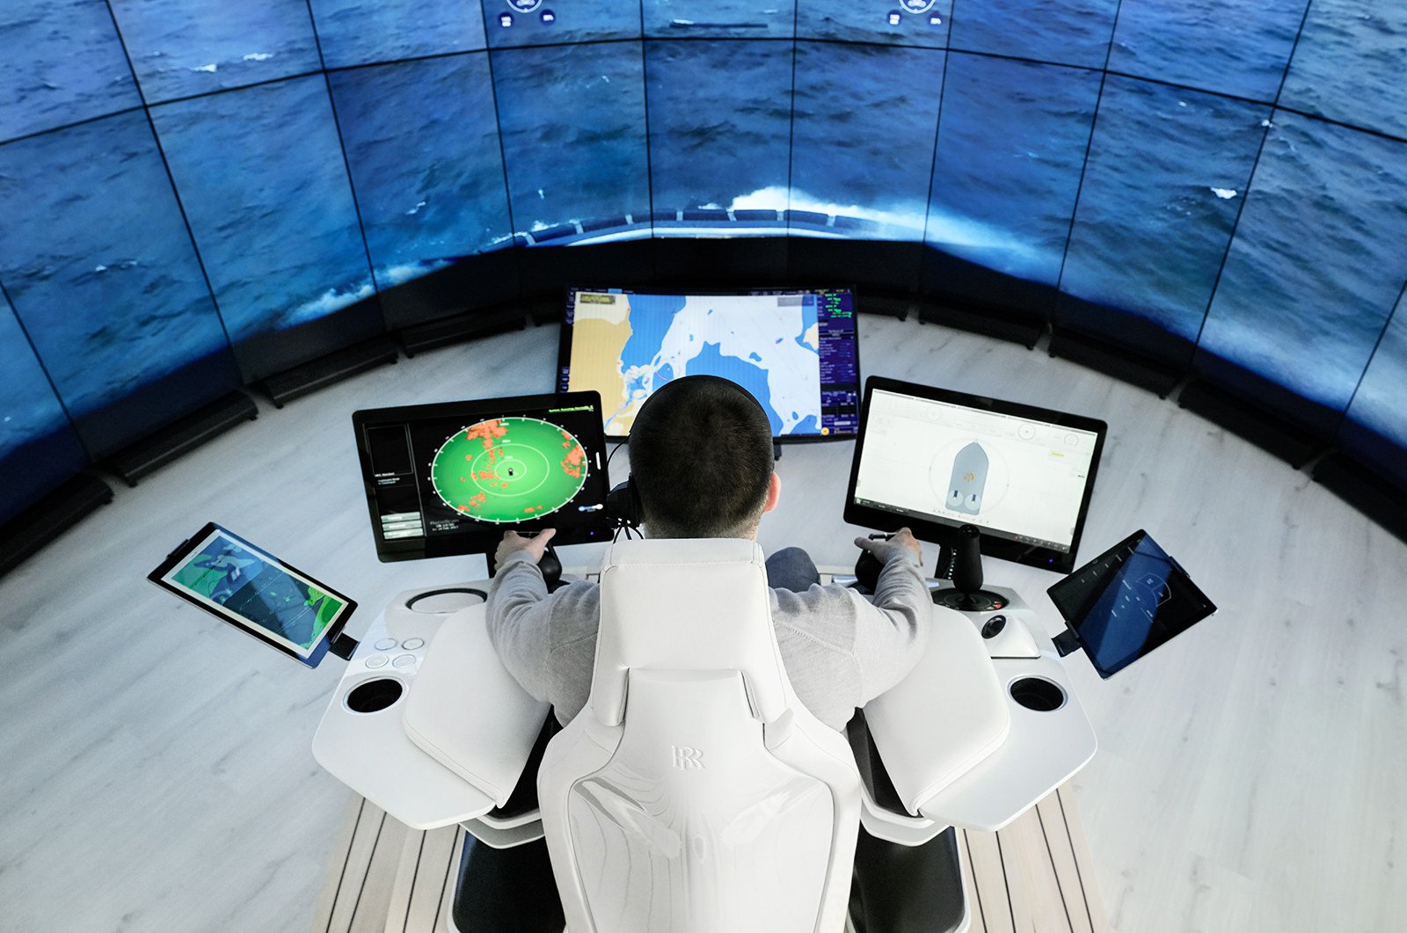
ROLLS ROYCE is using advances in digital technology to drive the development of remote shipping. The UK is at the forefront of developments in autonomous vessels.

Slide 7

INMARSAT owns and operates an unrivalled global satellite network, offering mobile and fixed communications services for the global maritime industry. The UK leads the world in information communication technology innovation.

Slide 8

LAND ROVER BAR, the British America’s Cup Challenger, has developed cutting-edge bone conductor technology with BAE SYSTEMS, allowing sailors to keep both their ears free in order to hear external sounds, whilst providing the ability to communicate clearly with crewmates in the most challenging of racing conditions. Innovative solutions like this are found across the UK’s maritime sector.

Slide 9
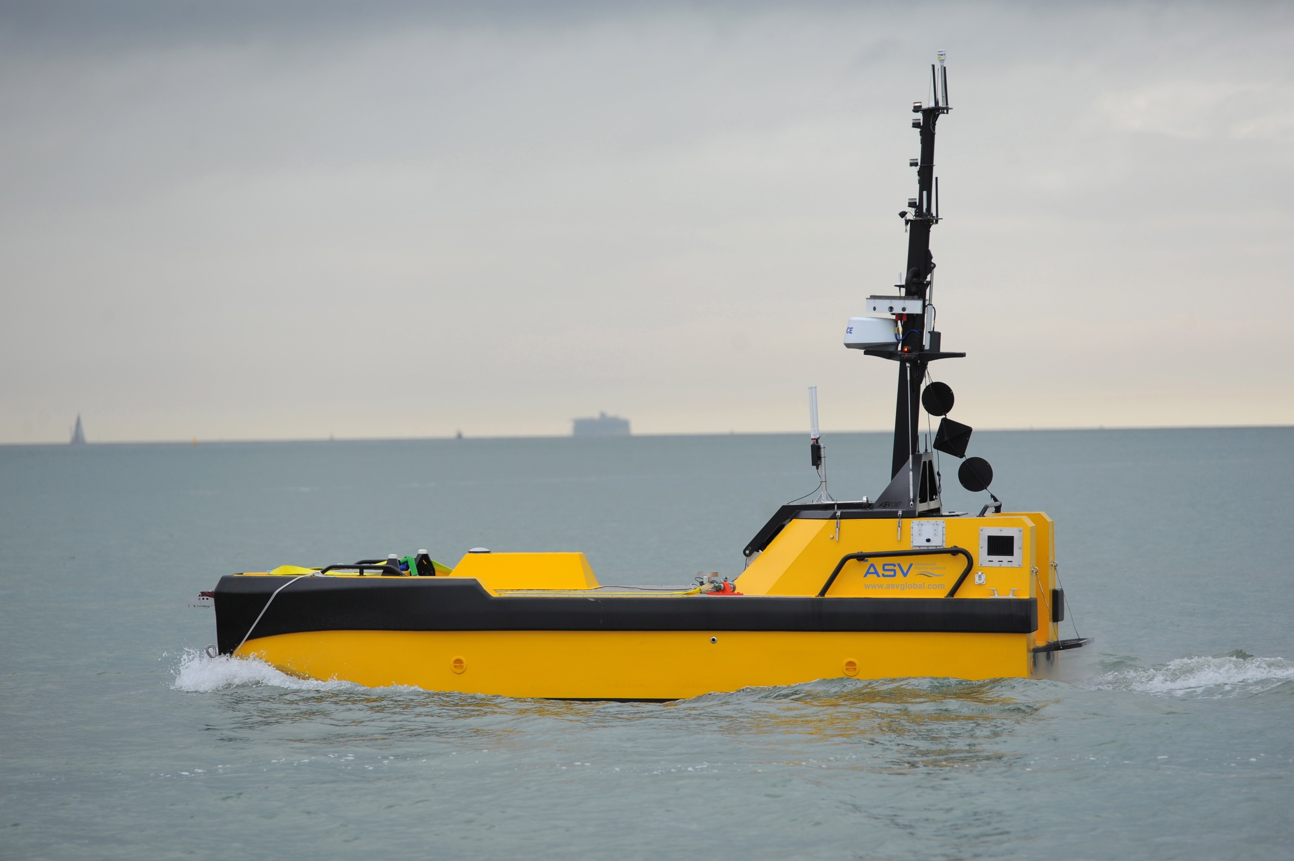
ASV GLOBAL leads in the development of autonomous systems for commercial, scientific, military and security customers. UK companies, together with educational institutions, are driving the autonomous revolution.

Slide 10
High-quality design & manufacturing

Slide 11
The UK offers high-quality and bespoke maritime design, ship building and manufacturing
Prestigious handcrafted yachts to complex and highly technical naval systems
Quality and reliability are ingrained

Slide 12
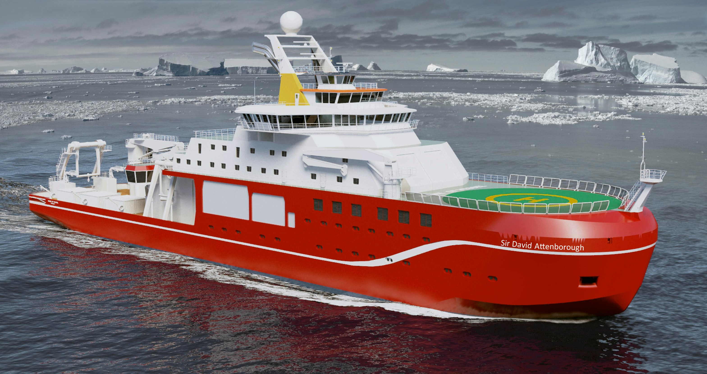
CAMMELL LAIRD is building the UK’s new polar research ship, RSS David Attenborough. She will be one of the most advanced research ships in the world, helping inspire the next generation of scientists and building upon the UK’s status as one of the world’s leading nations in polar science, engineering and technology.

Slide 13
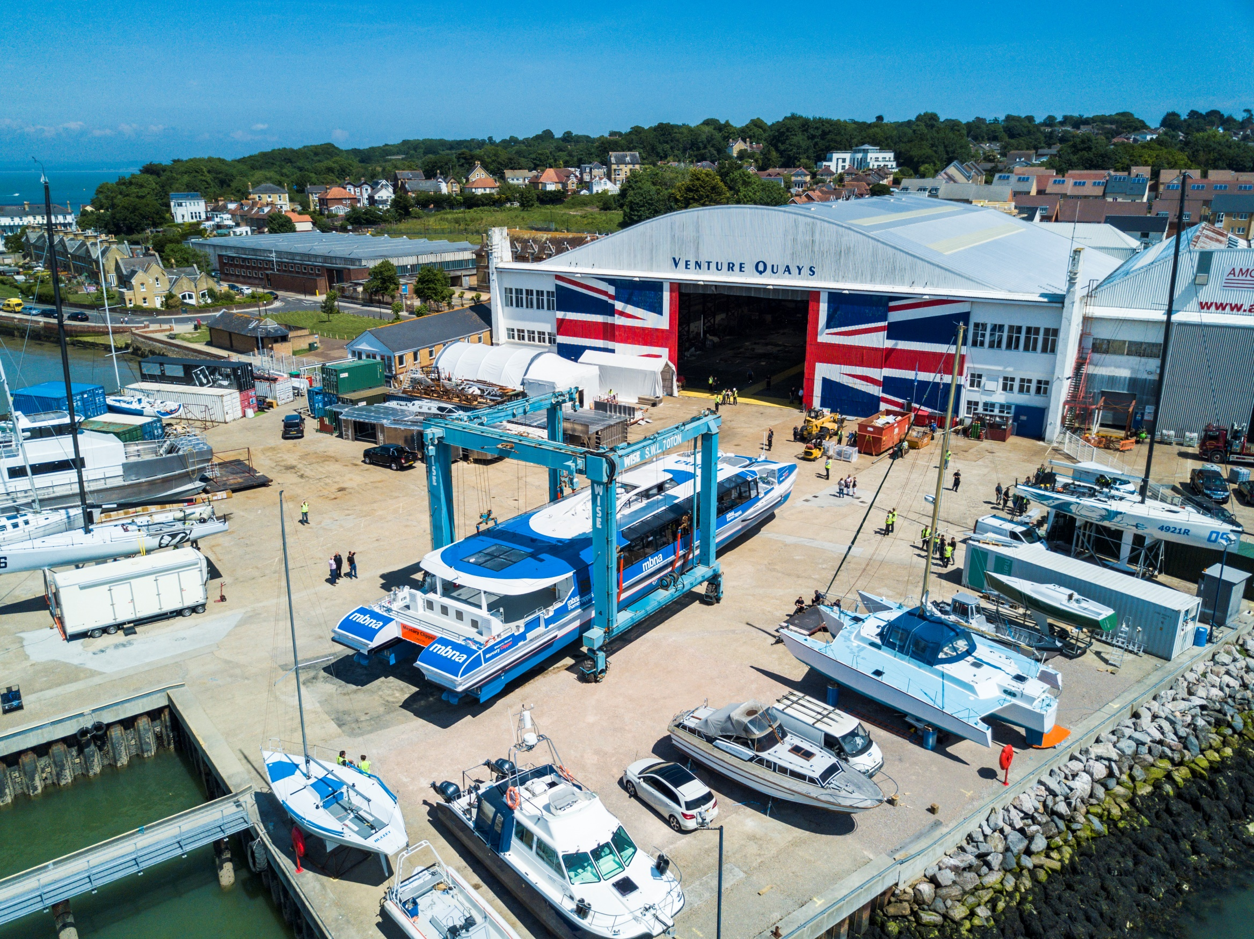
WIGHT SHIPYARD CO is redefining how fast ferries are built through innovative design and quality construction. This combination of innovation and quality is the hallmark of UK design and manufacturing.

Slide 14

SPIRIT YACHTS is among the most significant production designers and builders of modern classic yachts worldwide. The UK is home to numerous boat-builders and craftsmen offering prestigious, luxury, quality products.

Slide 15
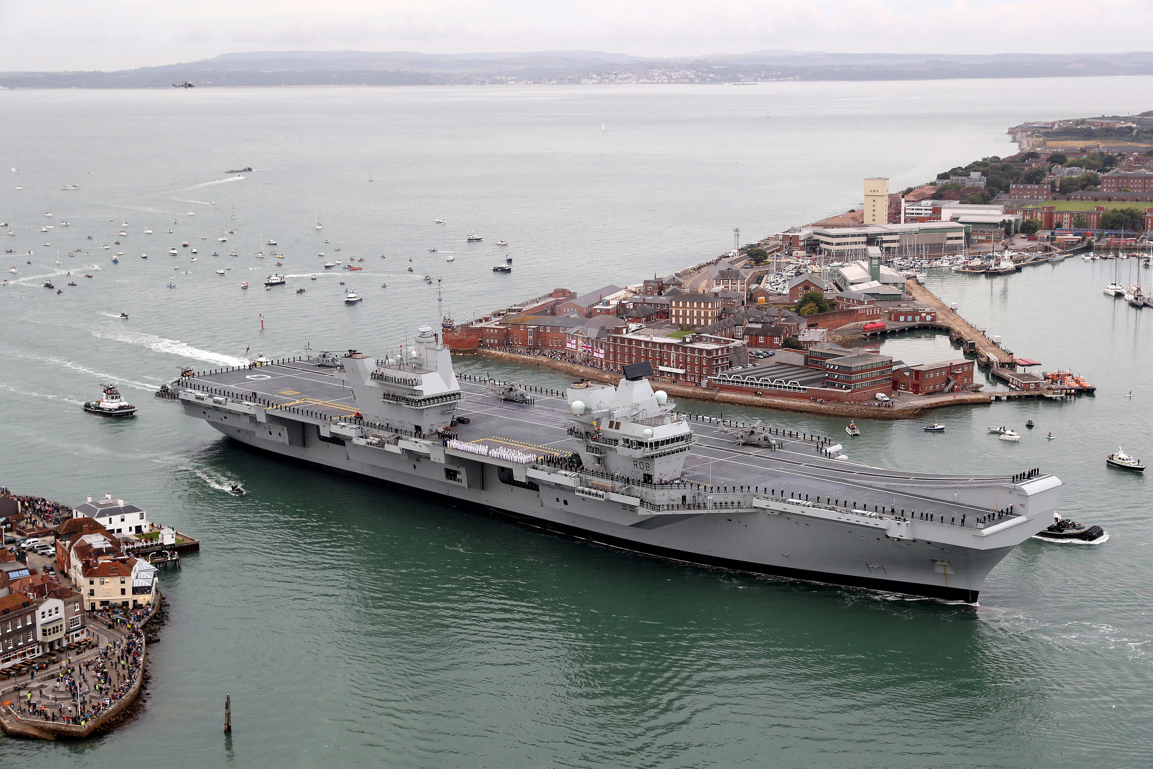
The AIRCRAFT CARRIER ALLIANCE, comprising BAE Systems, Thales UK, Babcock and the Ministry of Defence, is delivering aircraft carriers that will be the centrepiece of Britain’s defence capability for the 21st century. The skills, expertise and innovative thinking gained during development are available across the UK’s shipbuilding industry

Slide 16
Unparalleled services expertise

Slide 17
The UK is the undisputed global leader in maritime professional services
Vessel chartering, insurance, legal, financial and educational services.

Slide 18

The UK is the world’s leading centre for the provision of legal and arbitration services to the international maritime community, with over 40 LAW FIRMS active in the sector. English law continues to dominate as the preferred governing law for the world’s commercial contracts.

Slide 19
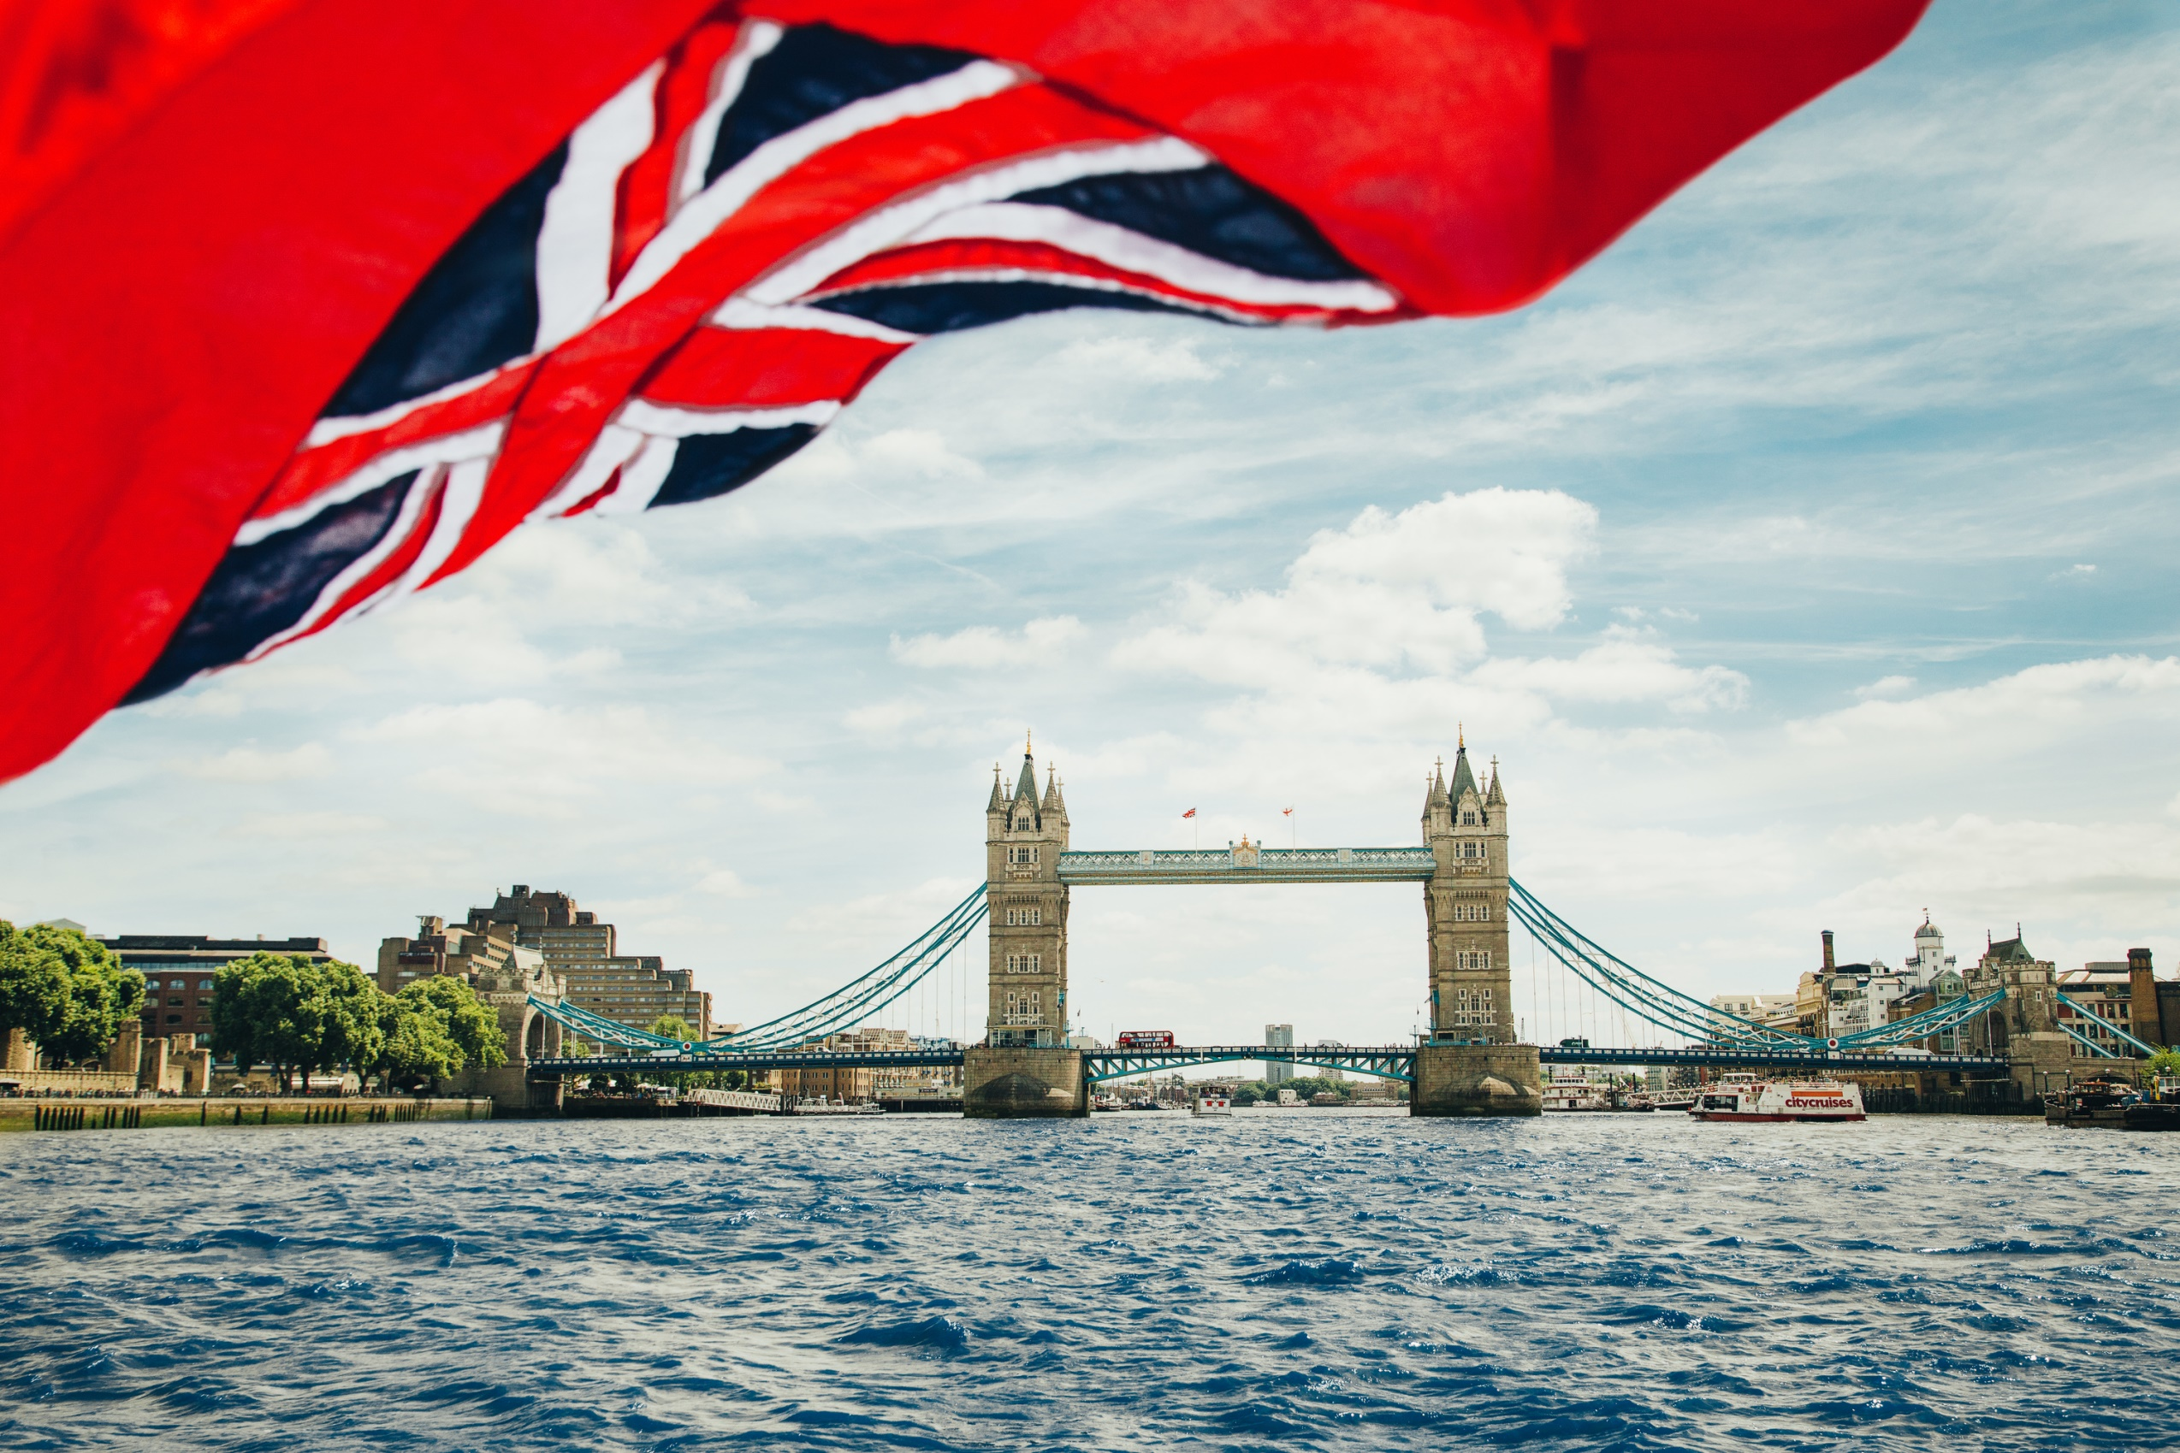
With the aim of delivering excellent customer service and flexibility, the UK FLAG is the quality option for quality owners in the 21st century. The UK Ship Register is one of the best performing flags on the major Port State Control Regimes. It has Qualship 21 status and is also highly ranked on the Paris and Tokyo MOU Whitelists.

Slide 20

LLOYD’S REGISTER is the oldest classification society in the world, helping clients design, construct and operate their assets to the highest levels of safety and performance.
LLOYD’S OF LONDON is the world’s leading insurance market providing specialist insurance services to businesses in over 200 countries and territories.
LLOYD’S LIST is one of the world’s oldest continuously running journals, having provided weekly shipping news in London since 1734.

Slide 21
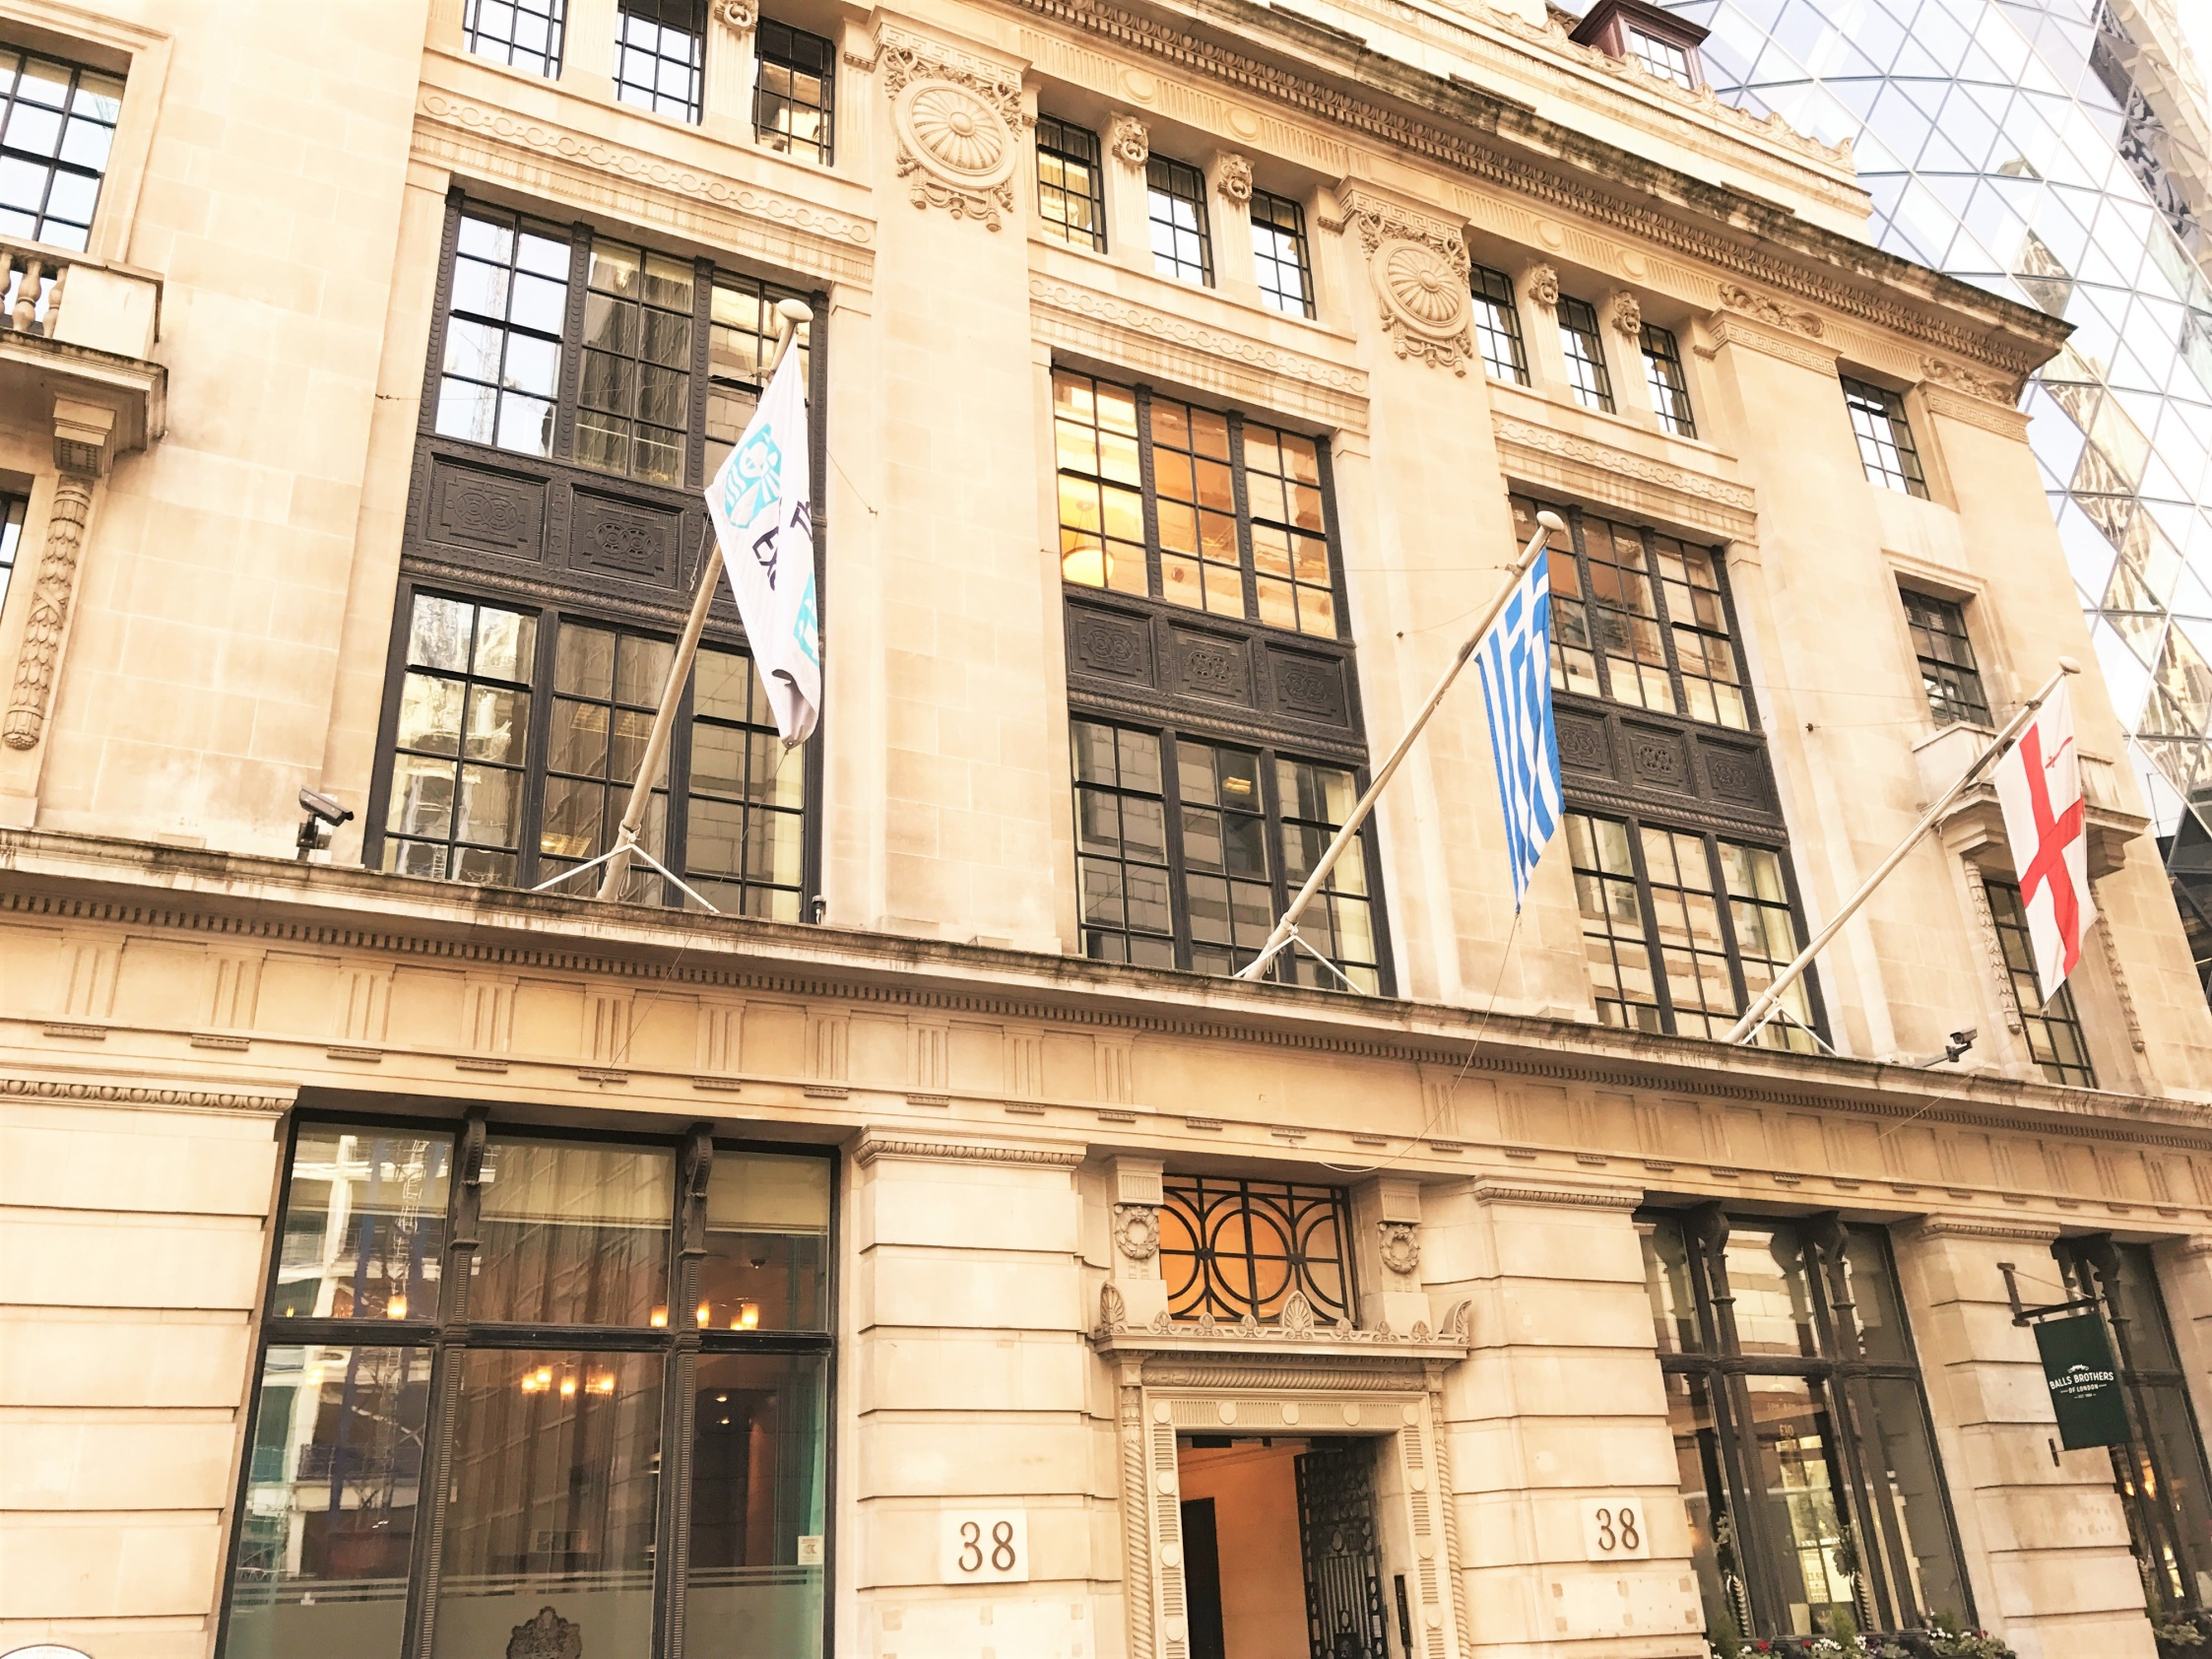
THE BALTIC EXCHANGE is the world’s only independent source of maritime market information for the trading and settlement of physical and derivative contracts.

Slide 22
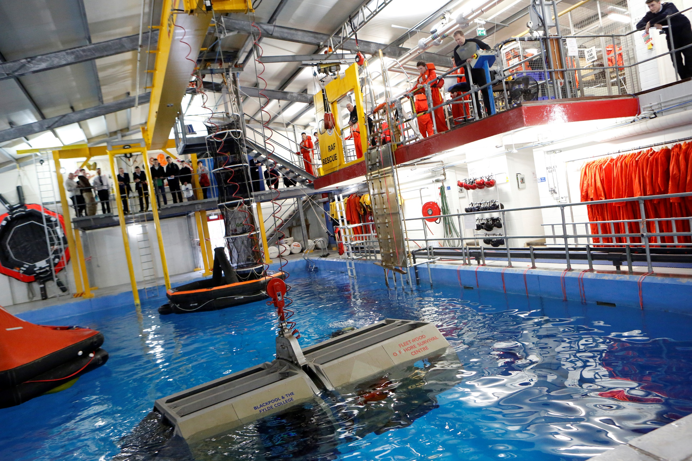
From seafarer training facilities like FLEETWOOD or CITY OF GLASGOW COLLEGE, to THE COSTAS GRAMMENOS CENTRE FOR SHIPPING TRADE AND FINANCE at CASS or THE GLOBAL TECHNOLOGY CENTRE at Southampton, the UK offers a vast array of high-quality, innovative and ground-breaking education, training and academic research.

Slide 23
Major investment opportunities

Slide 24
The UK is the perfect base from which to access markets worldwide
Competitive business environment
Internationally competitive tax regime – including the lowest corporation level in the G20
Attractive Tonnage Tax regime for shipowners.

Slide 25
Few barriers to starting or growing a business
Versatile time zone
Global language
Access to top talent
Connected infrastructure and government commitment to further significant investment

Slide 26

The UK is one of the leading business locations in the world and the number-one European destination for inward investment. Global maritime businesses choose to base themselves in the UK because of the complete package offered by our maritime centre.

Slide 27
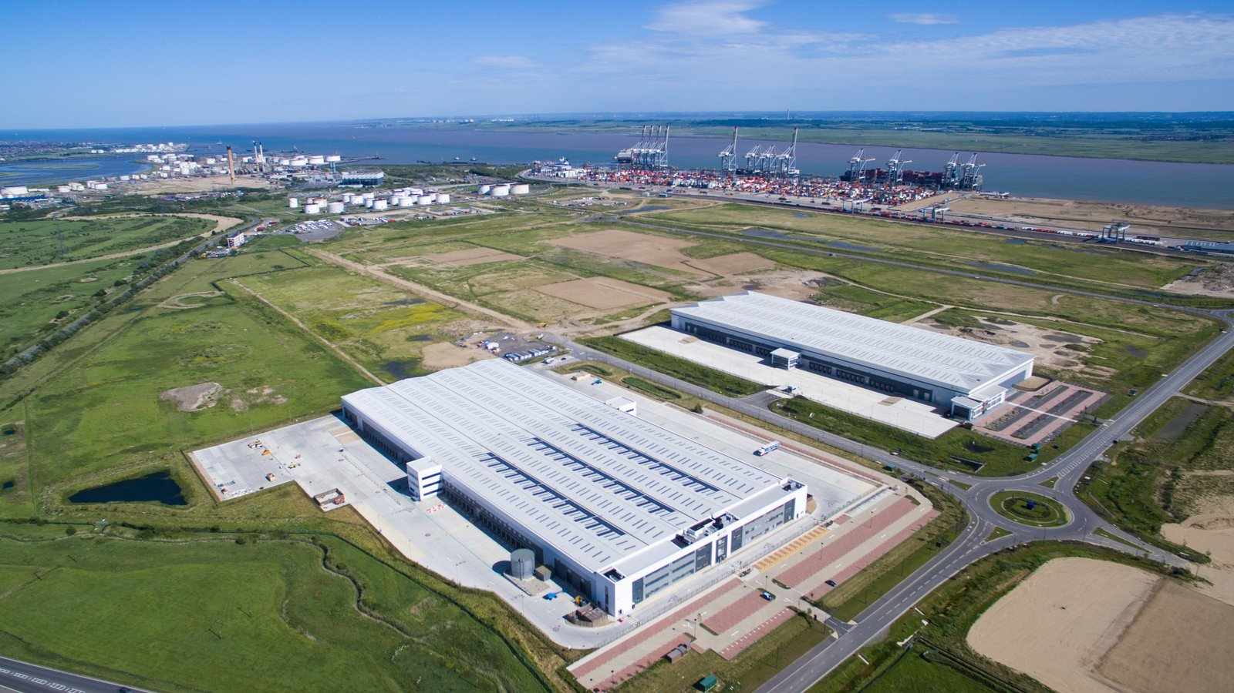
UK PORTS offer more than 900 hectares of developable land across the country offering an ideal location for high value manufacturing. Sites like DP WORLD’S LONDON GATEWAY LOGISITICS PARK offer outstanding connectivity by road, rail and sea to the UK and Europe providing enhanced supply chain operations

Slide 28
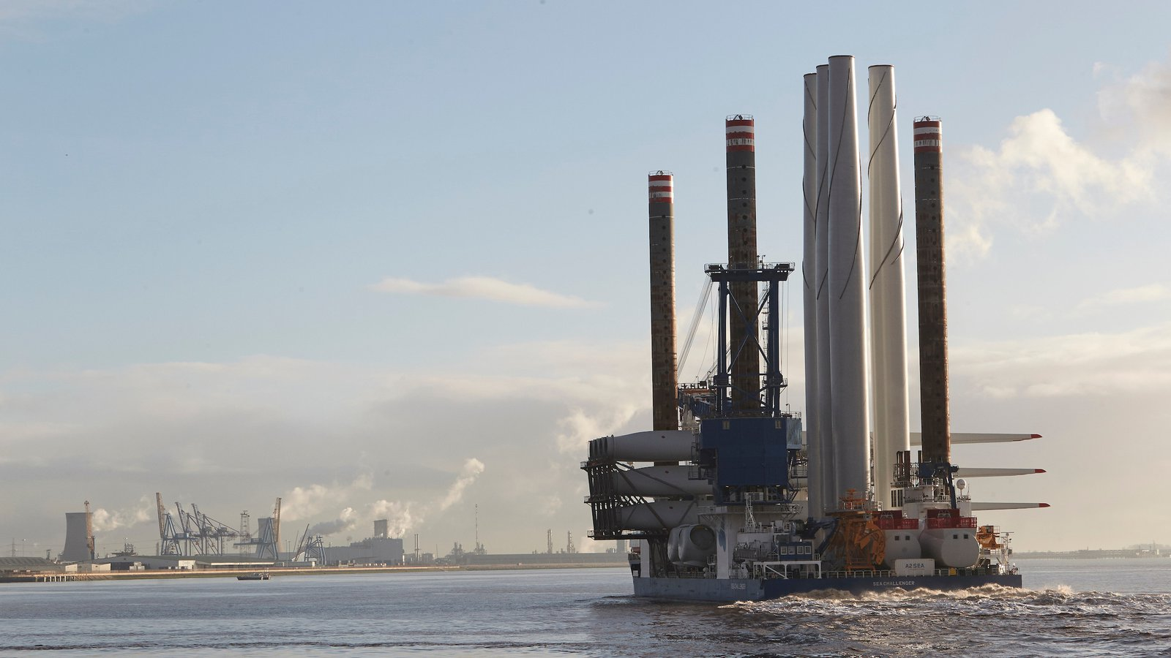
ABP-SIEMENS The joint venture between Associated British Ports and Siemens has seen £310 million investment at Alexandra Docks in the City of Hull for the development of a wind turbine blade manufacturing facility. Such well-connected manufacturing, energy and high tech logistics opportunities exist at ports across the UK.

Slide 29
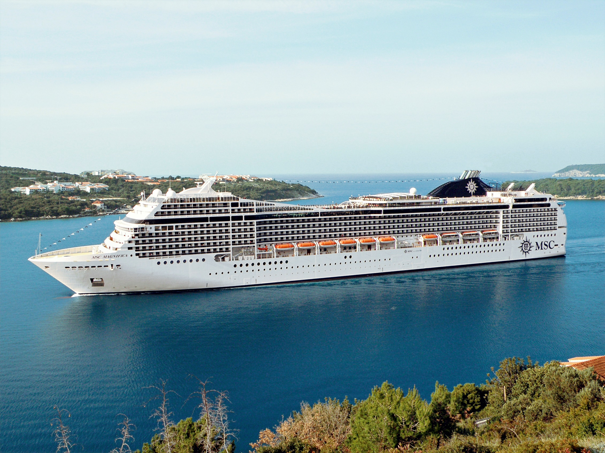
“The UK offers an unrivalled cluster of expertise and services to global maritime businesses. This foundation, coupled with a rapidly growing domestic cruise market, made the UK the obvious and natural choice for our move.”

Slide 30
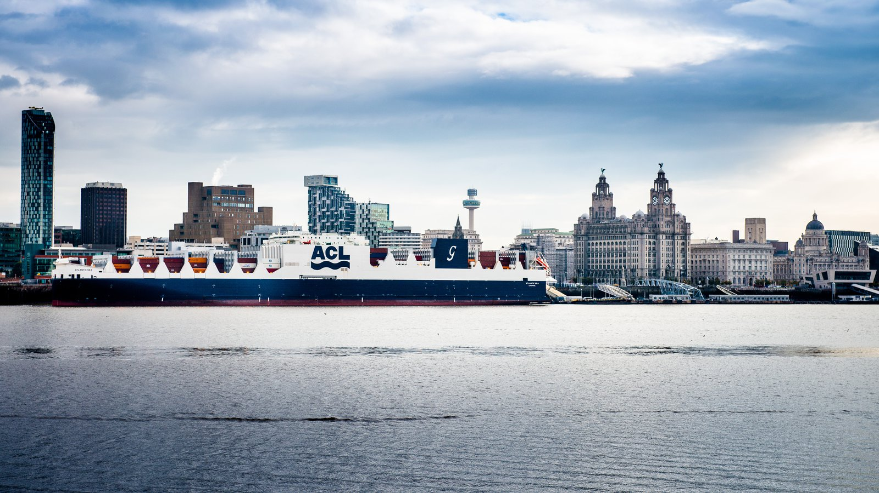
"We have two offices – in London and Liverpool – and value the UK as a world-leading maritime centre, built upon strong maritime heritage, with a competitive business environment and access to skilled and experienced professionals.

Slide 31
We look forward to partnering with you to create tomorrow’s maritime world

